Slide 1


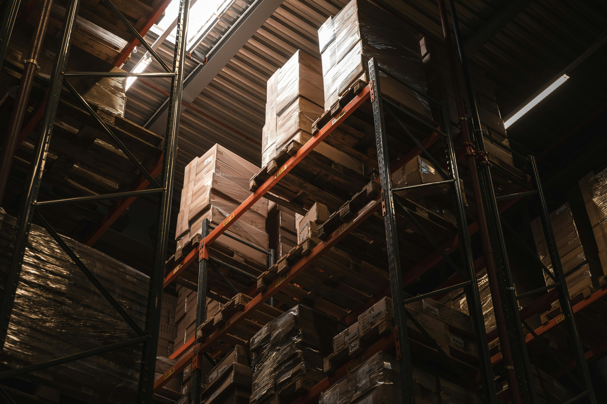
PAGE 01
LOGISTICS PROJECT PRESENTATION
AUTOMATED RAIL-BASED LOADING & UNLOADING SYSTEM
PRESENTED BY GROUP 1

Slide 2
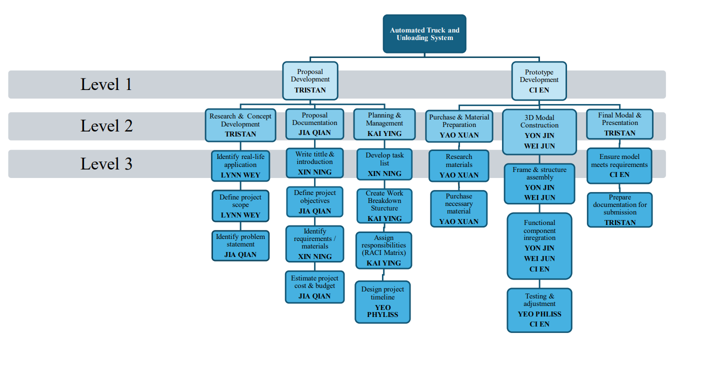
PAGE 02
1
4
WORK BREAKDOWN STRUCTURE

Slide 3


Slide 4


PAGE 04
PROBLEM STATEMENT
1
Inefficient loading and unloading process
Time-consuming process and labor intensive.
2
3
High operational costs.

Slide 5
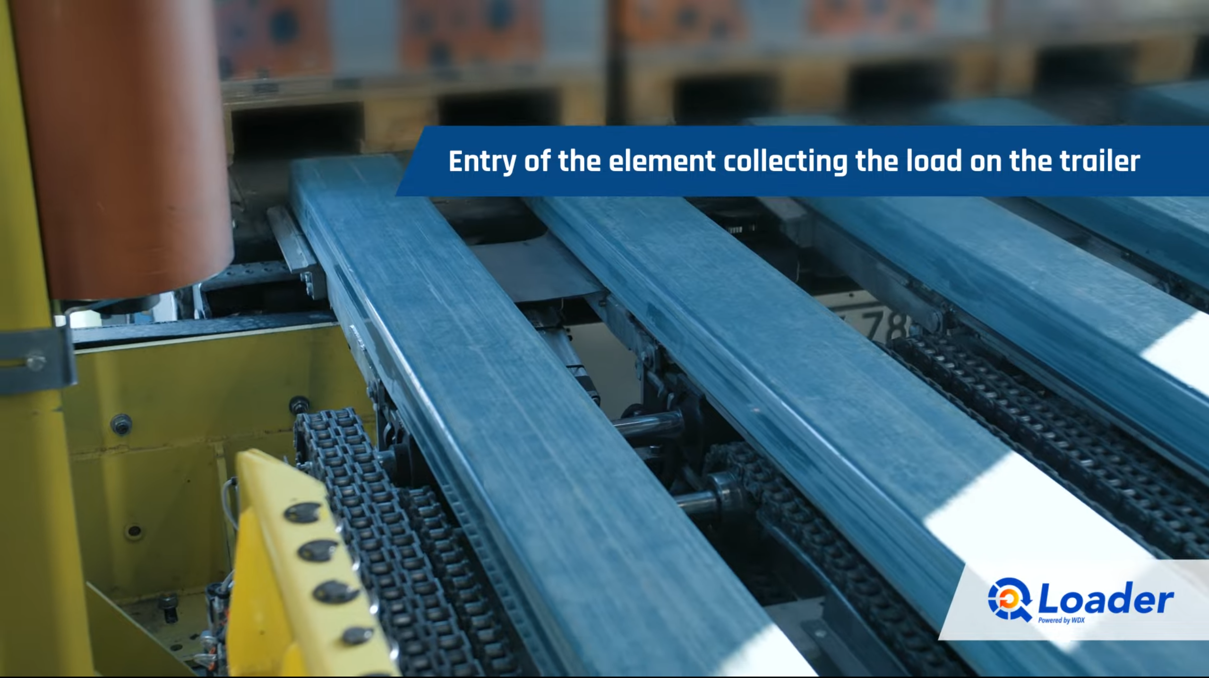
PAGE 05
SOLUTION
AUTOMATED TRUCK LOADING & UNLOADING SYSTEM

Slide 6
PAGE 06

Slide 7


PAGE 07
BENEFITS
  GREEN SOLUTION
  EFFICIENCY
  BETTER UTILIZATION OF MANPOWER

Slide 8
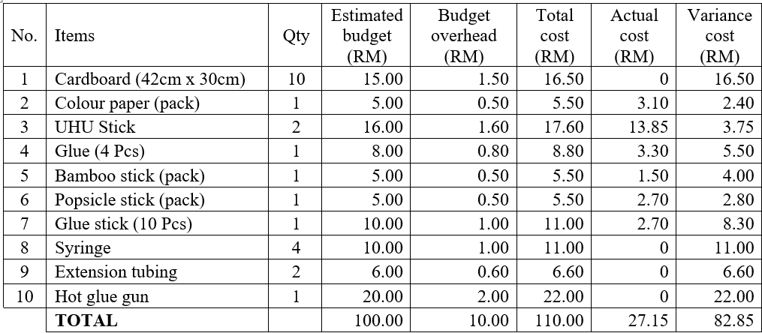
Costings
PAGE 09

Slide 9
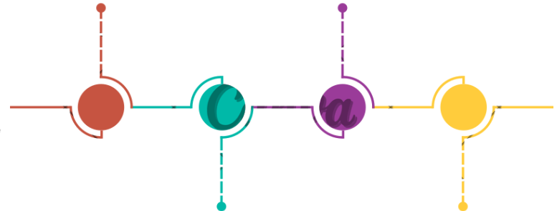
OUR TIMELINE
19TH FEB
11TH MAR
STARTED PROPOSAL WRITING
COMPLETED OUR PROTOTYPE
  Objective
  Problem Statement
  Ideas
  Combination of components
21ST & 26TH MAR
14TH FEB
PRESENTATION & SHOWCASE
STARTING
  detemined to do this title
  Prepare materials
25TH FEB
13TH MAR
COMPLETED BASIC PROTOTYPE
COMPLETED REPORT
  Truck Model
  Pallet
  Add in Grant Chart
  Costings

Slide 10
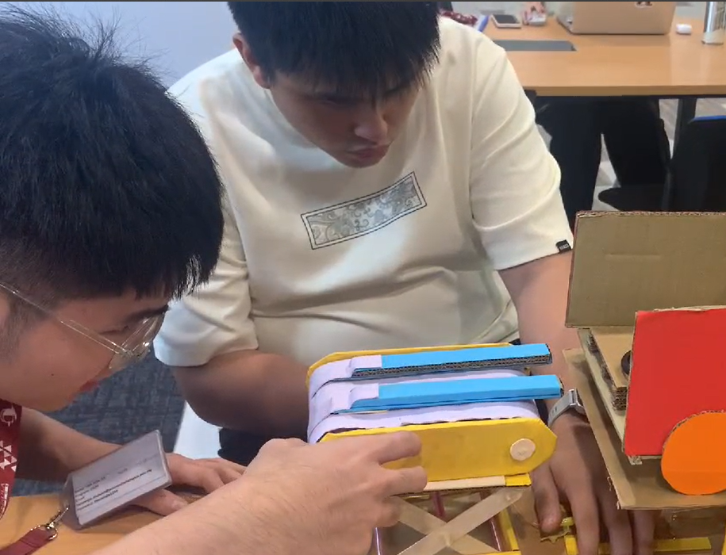
PAGE 11
THANK YOU FOR YOUR TIME
LOGISTICS PRESENTATION

