Slide 1
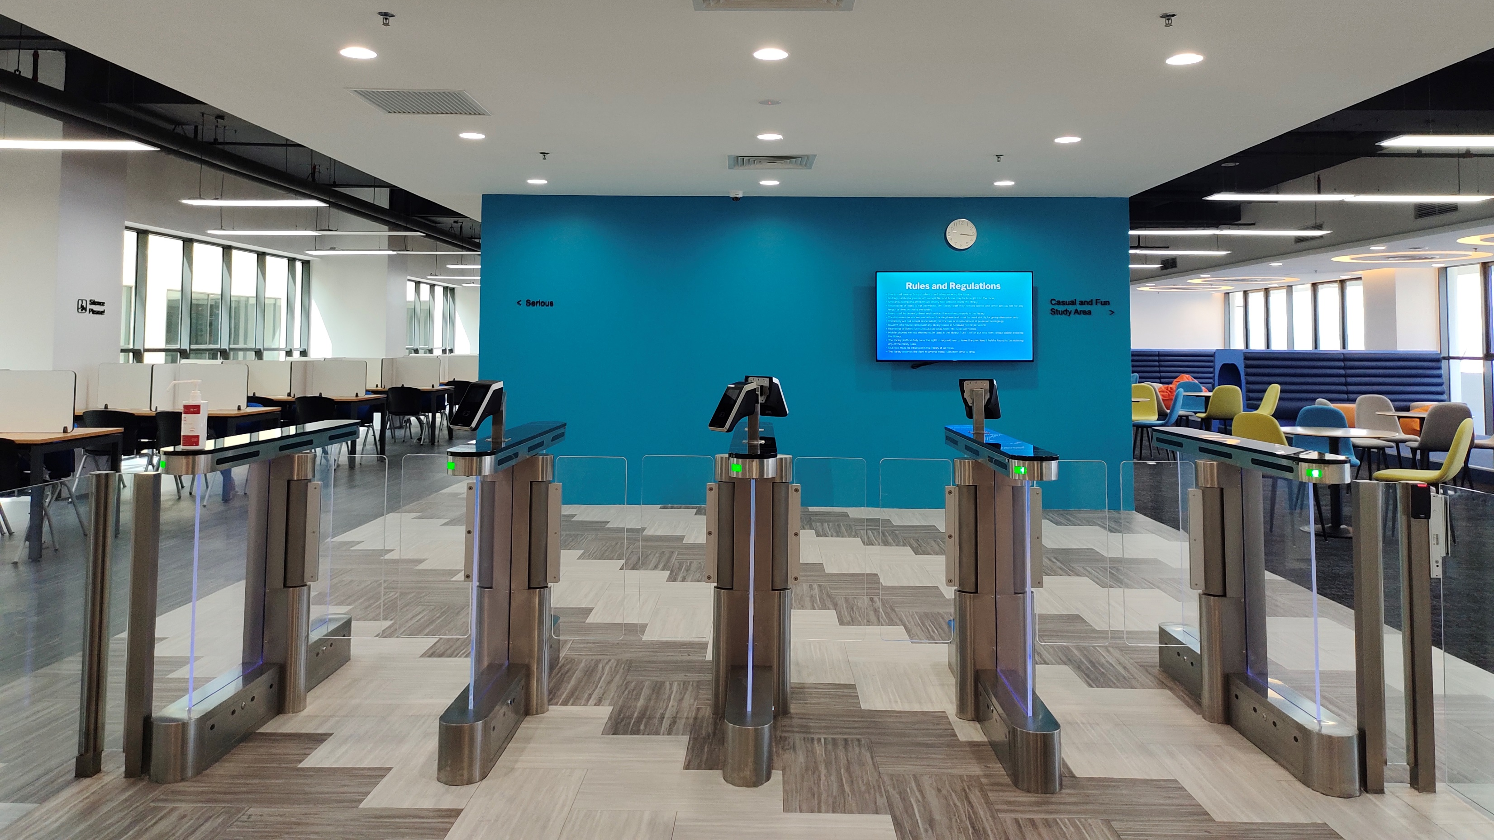


FRANCIS LIGHT LIBRARY BRIEFING
By : Noor Shahidah Binti Abdul Samad

Slide 2
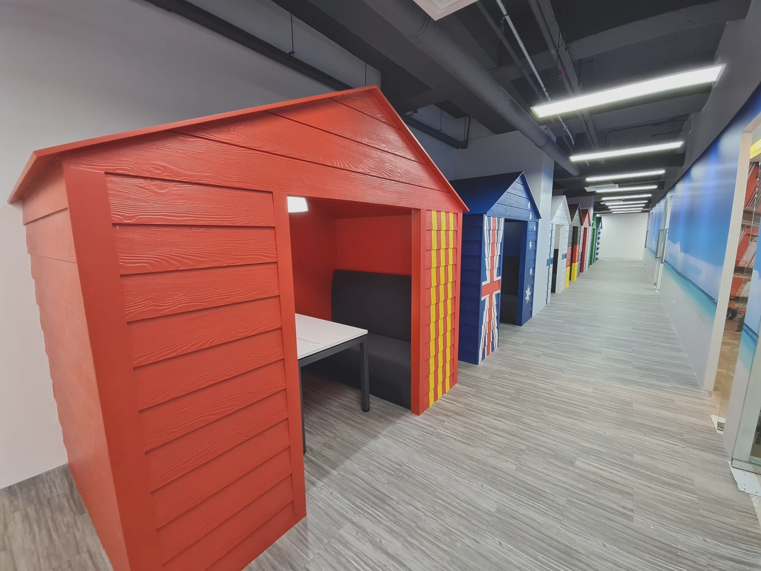

CONTENTS
PART 1 (LIBRARY INTRODUCTION)
PART 2 (ACCESS TO ONLINE LIBRARY RESOURCES)
Opening Hours, Do & Don’t, Collection, Services, Spaces, Facilities
Borrowing, Renewal, Hold on Item policy
Overdue Fine, Damage and Lost Item Policy
How to book a discussion room
Library Web Landing page
OPAC (Online Public Access Catalog)
Proquest ebook Central
Francis Light Digital Library (Dspace)
U-Pustaka
UOP Electronic Library

Slide 3
  PART 1 :
  LIBRARY INTRODUCTION
  Opening Hours, Do & Don’t, Collection, Services, Spaces, Facilities
  Borrowing, Renewal, Hold on Item policy
  Overdue Fine, Damage and Lost Item Policy
  How to book a discussion room
  Library Web Landing page
  OPAC (Online Public Access Catalog)

Slide 4
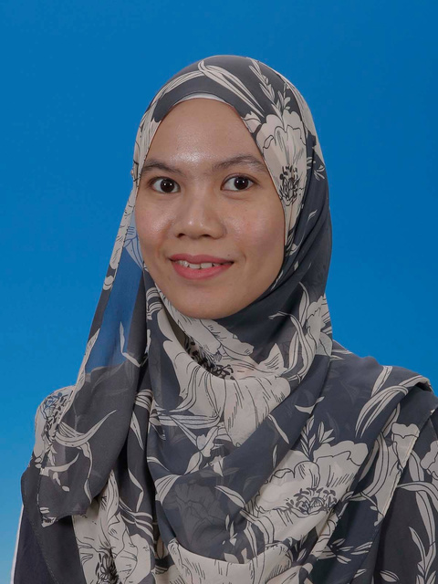
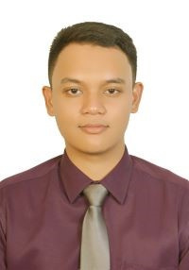

LIBRARY STAFF
Noor Shahidah
Librarian
noorshahidah@peninsulacollege.edu.my
OPENING HOURS
Monday to Friday : 8.00 am - 5.30 pm
Saturday & Sunday : Closed
Public Holidays : Closed
Revision & Exam Week : 8.00 am – 9.00 pm
Muhammad Jazly Hanif
Asst. Librarian
jazlyhanif@peninsulacollege.edu.my

Slide 5
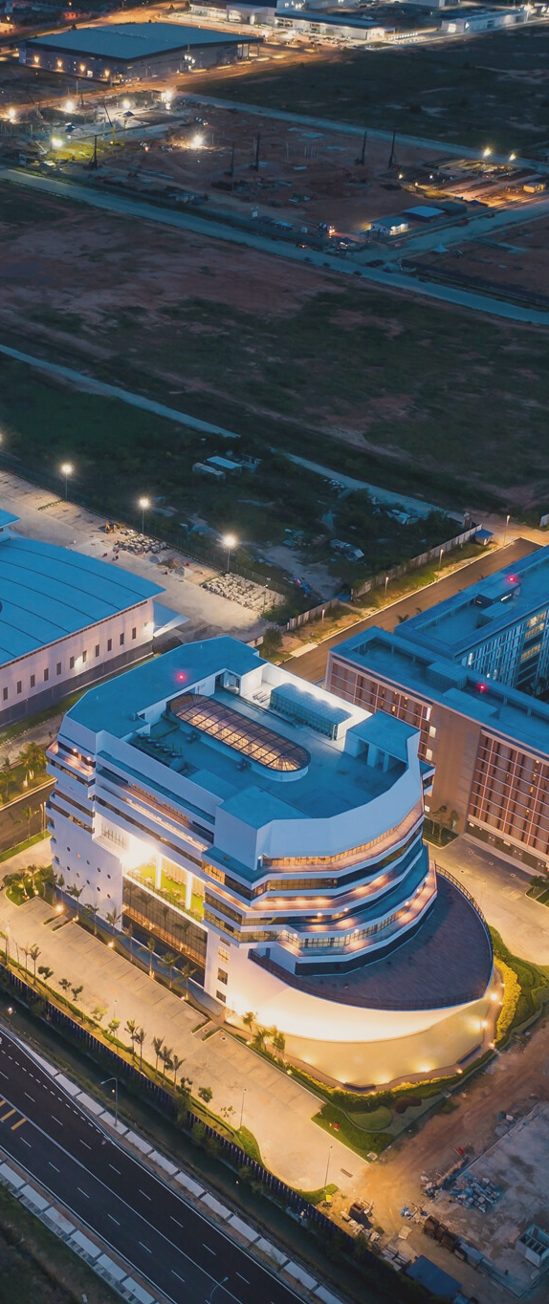


RULES AND REGULATIONS
  Wear users’s ID.
  Wear a proper attire with acceptable dress code
  Responsible to own belonging
  Silence your mobile phone
  Be gentle to the library books furniture and facilities
  Silence all the time
  Talk in acceptable level
  Smoking, eating and drinking
  Seat reservation
  Vandalized library items and furnitures
  Rearrange of the library furniture.

Slide 6
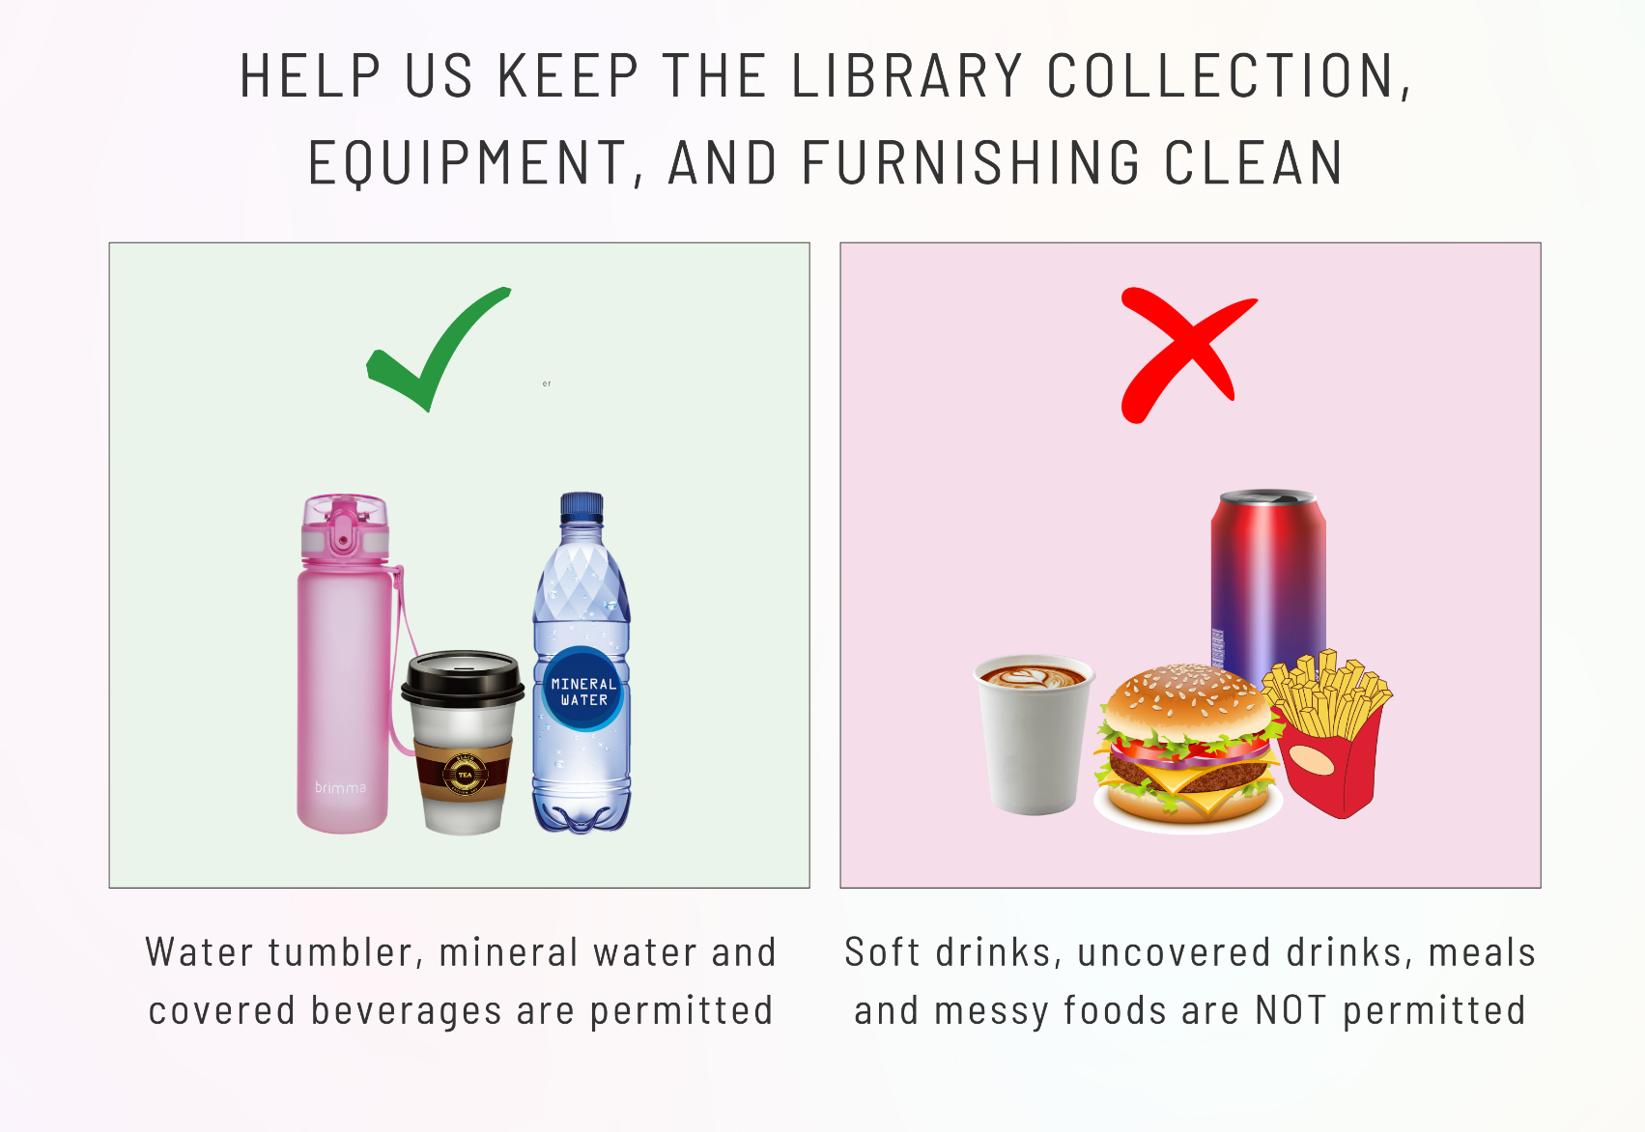
FOOD & DRINK POLICY
Noor Shahidah

Slide 7


LIBRARY POLICIES
BORROWING
  Must be done at the circulation counter.
  Produce staff ID card
  Borrowers are responsible for all materials borrowed under their names.
  Lost/damaged materials should be reported immediately.
MEMBER CATEGORY
RS
STUDENTS
3 BOOKS / 1 WEEK
-
FULL TIME LECTURER
4 BOOKS / 4 MONTH
2 BOOKS / 1 WEEK
PART TIME LECTURER
2 BOOKS / 3 MONTH
1 BOOKS / 1 WEEK
NON-ACADEMIC STAFF
2 BOOKS / 1 MONTH
1 BOOKS / 1 WEEK

Slide 8
LIBRARY POLICIES
RENEWALS
  Can be done twice.
  Renewal for overdue books are not allowed.
RETURNING
  Return before the due date or on the due date.
  Books must be return to the librarian at the library counter.
  Users who have outstanding fines will have their borrowing privileges suspended until the fines are settled.
  Overdue notice will be sent to the users by email.

Slide 9

LIBRARY POLICIES
OVERDUE FINES RATE
RM 1.00 PER DAY / ITEM
  Account suspended until fines being paid
BOOK RESERVATION
  Users can reserve books online or at the circulation counter.
  User will be notified by email when a reserved item is available.
  Only 2 books can be reserve at once.
  Reserved item will be kept for three days.

Slide 10
LIBRARY POLICIES
BOOK LOST / DAMAGED BOOKS
  Reported immediately
  Replacement / payment must be made within 4 weeks from the date reported lost.
  Payments for replacement of lost/damaged materials are not returnable after a month from the date the payment is made.
Book replacement (latest edition) + RM30 (processing fee) + Overdue fine (if any)
Pay book market price + RM30 (processing fee) + Overdue fine
(if any)
Book Replacement
Cost Replacement

Slide 11

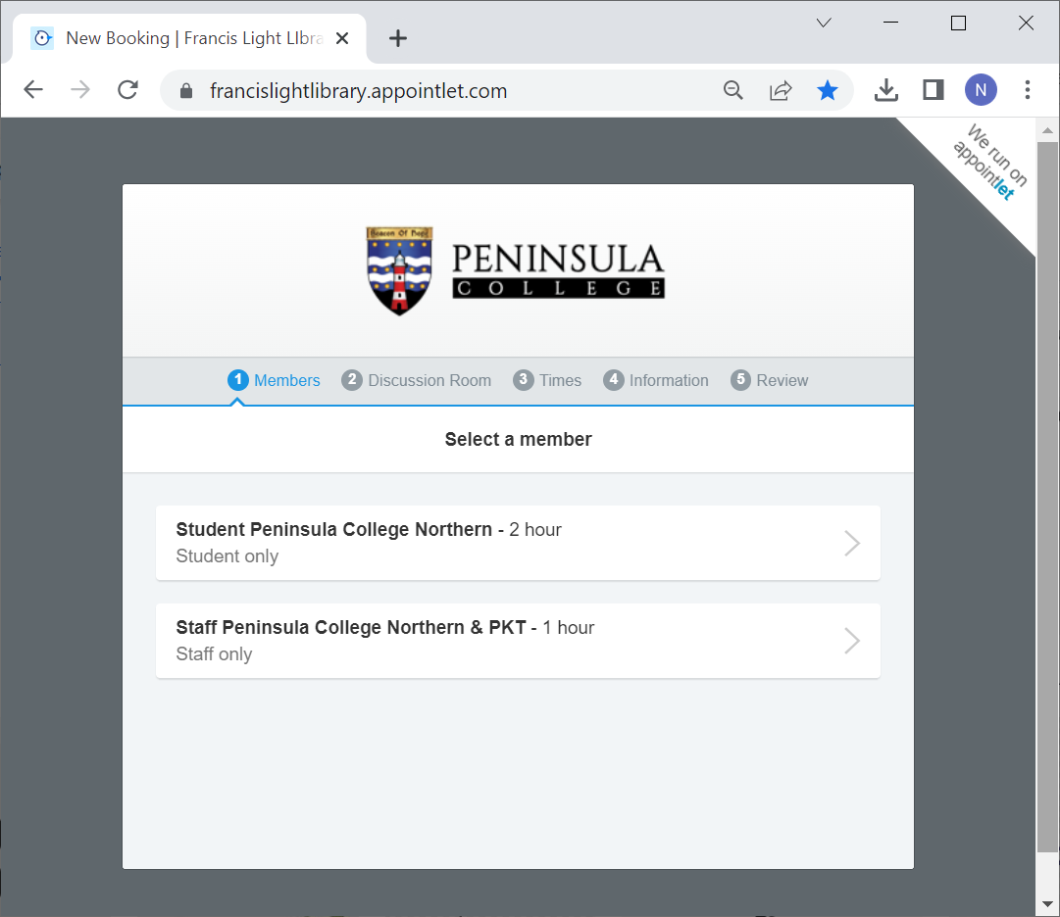
LIBRARY POLICIES
LIBRARY DISCUSSION ROOM POLICY
www.francislightlibrary.appointlet.com
  Booking online
  Number of users : 3 (minimum) and 8 (maximum)
  The use of the room is limited to a maximum of THREE (3) hours per usage. Discussion rooms may be used for extended periods of time on library staff consideration.
  Users who intentionally damage the facilities will be fined RM50.00.
  Please ensure that the room is clean before you leave.

Slide 12
LIBRARY POLICIES
LIBRARY DISCUSSION ROOM POLICY
Cont...
The following are not allowed inside the discussion rooms:
  Food is not permitted.
  Loud noises.
  Bringing in additional chairs/other pieces of furniture.
  Leaving any kind of garbage including paper/plastic, etc.

Slide 13




LIBRARY COLLECTIONS
OPEN SHELF
REFERENCES
RED SPOT
ONLINE RESOURCES
Proquest e-book Sentral
Francis Light Digital Library (Dspace)
U-Pustaka
Textbook and main references
Leisure reading collection [LR]
Includes dictionaries, encyclopedia, handbook, directories and related references. [REF]
Collection of textbooks and reference books which are not for loan. High demand /limited or expasive references. [RS]

Slide 14
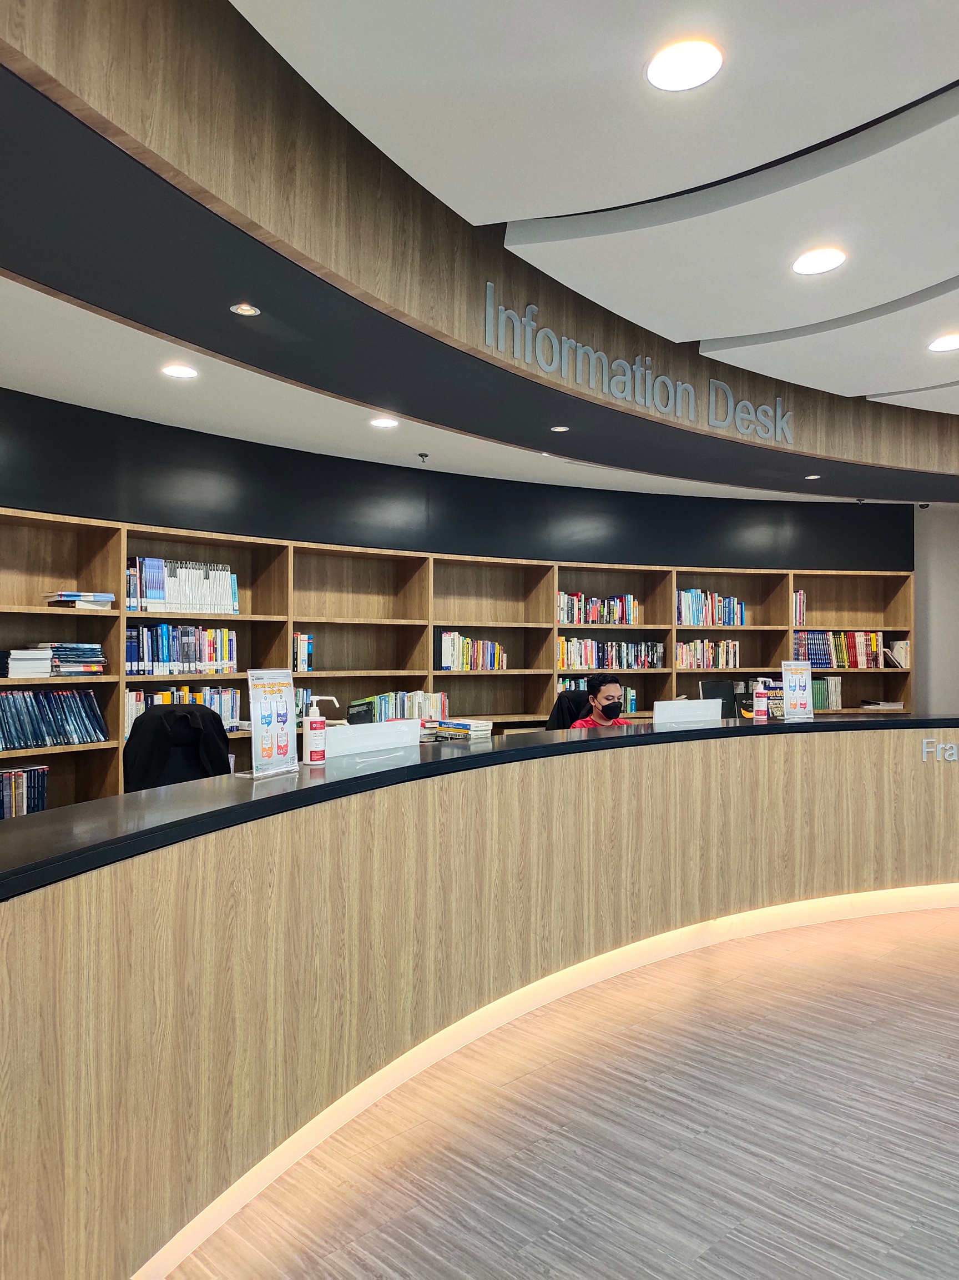
LIBRARY SERVICES
  Circulation services
    Book borrowing and returning
    Renewal and reservation
  Reference services
    Library induction
    Library Info. Literacy Class
  Printing and photocopying services
  Discussion room reservation

Slide 15
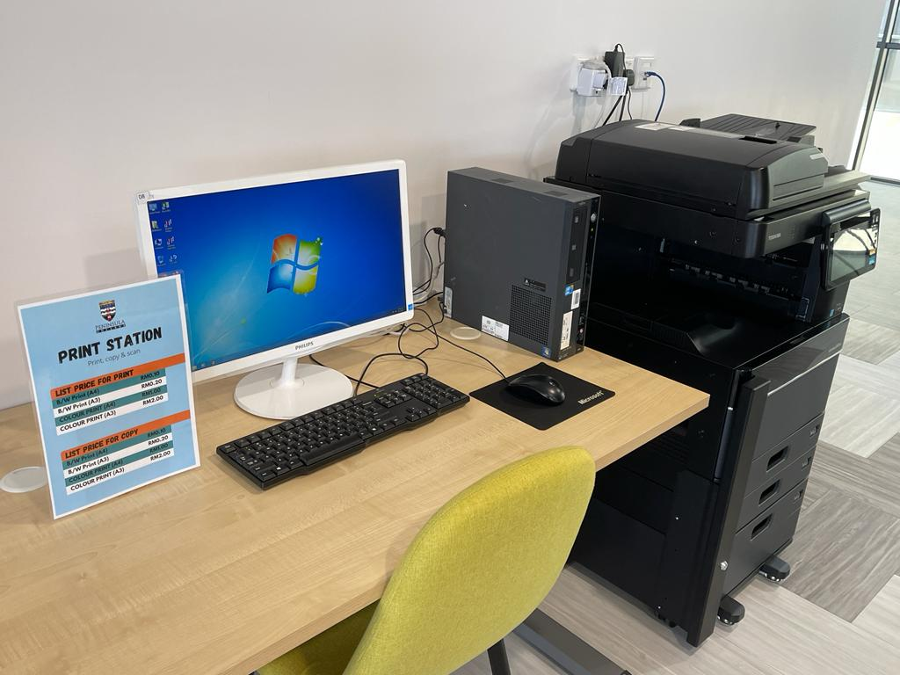

PRINT AND PHOTOCOPY SERVICE
  Printing, scanning and photocopying services are available in the library.
  First time users need to register at the library counter.
  Minimum reload / top-up is RM10.00.
PRINT & COPY PRICE
Black & White (A4) RM0.10
Colour (A4) RM1.00
Black & White (A3) RM0.20
Colour (A3) RM2.00

Slide 16
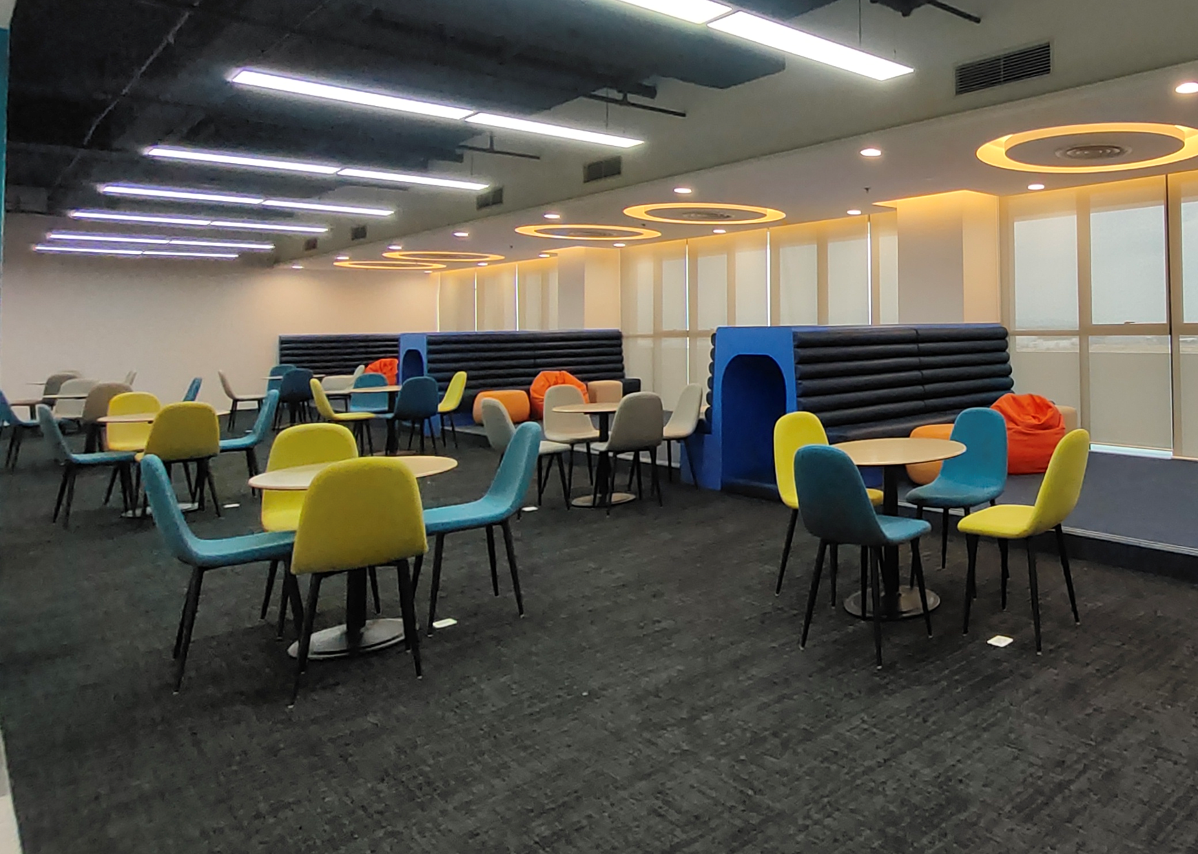
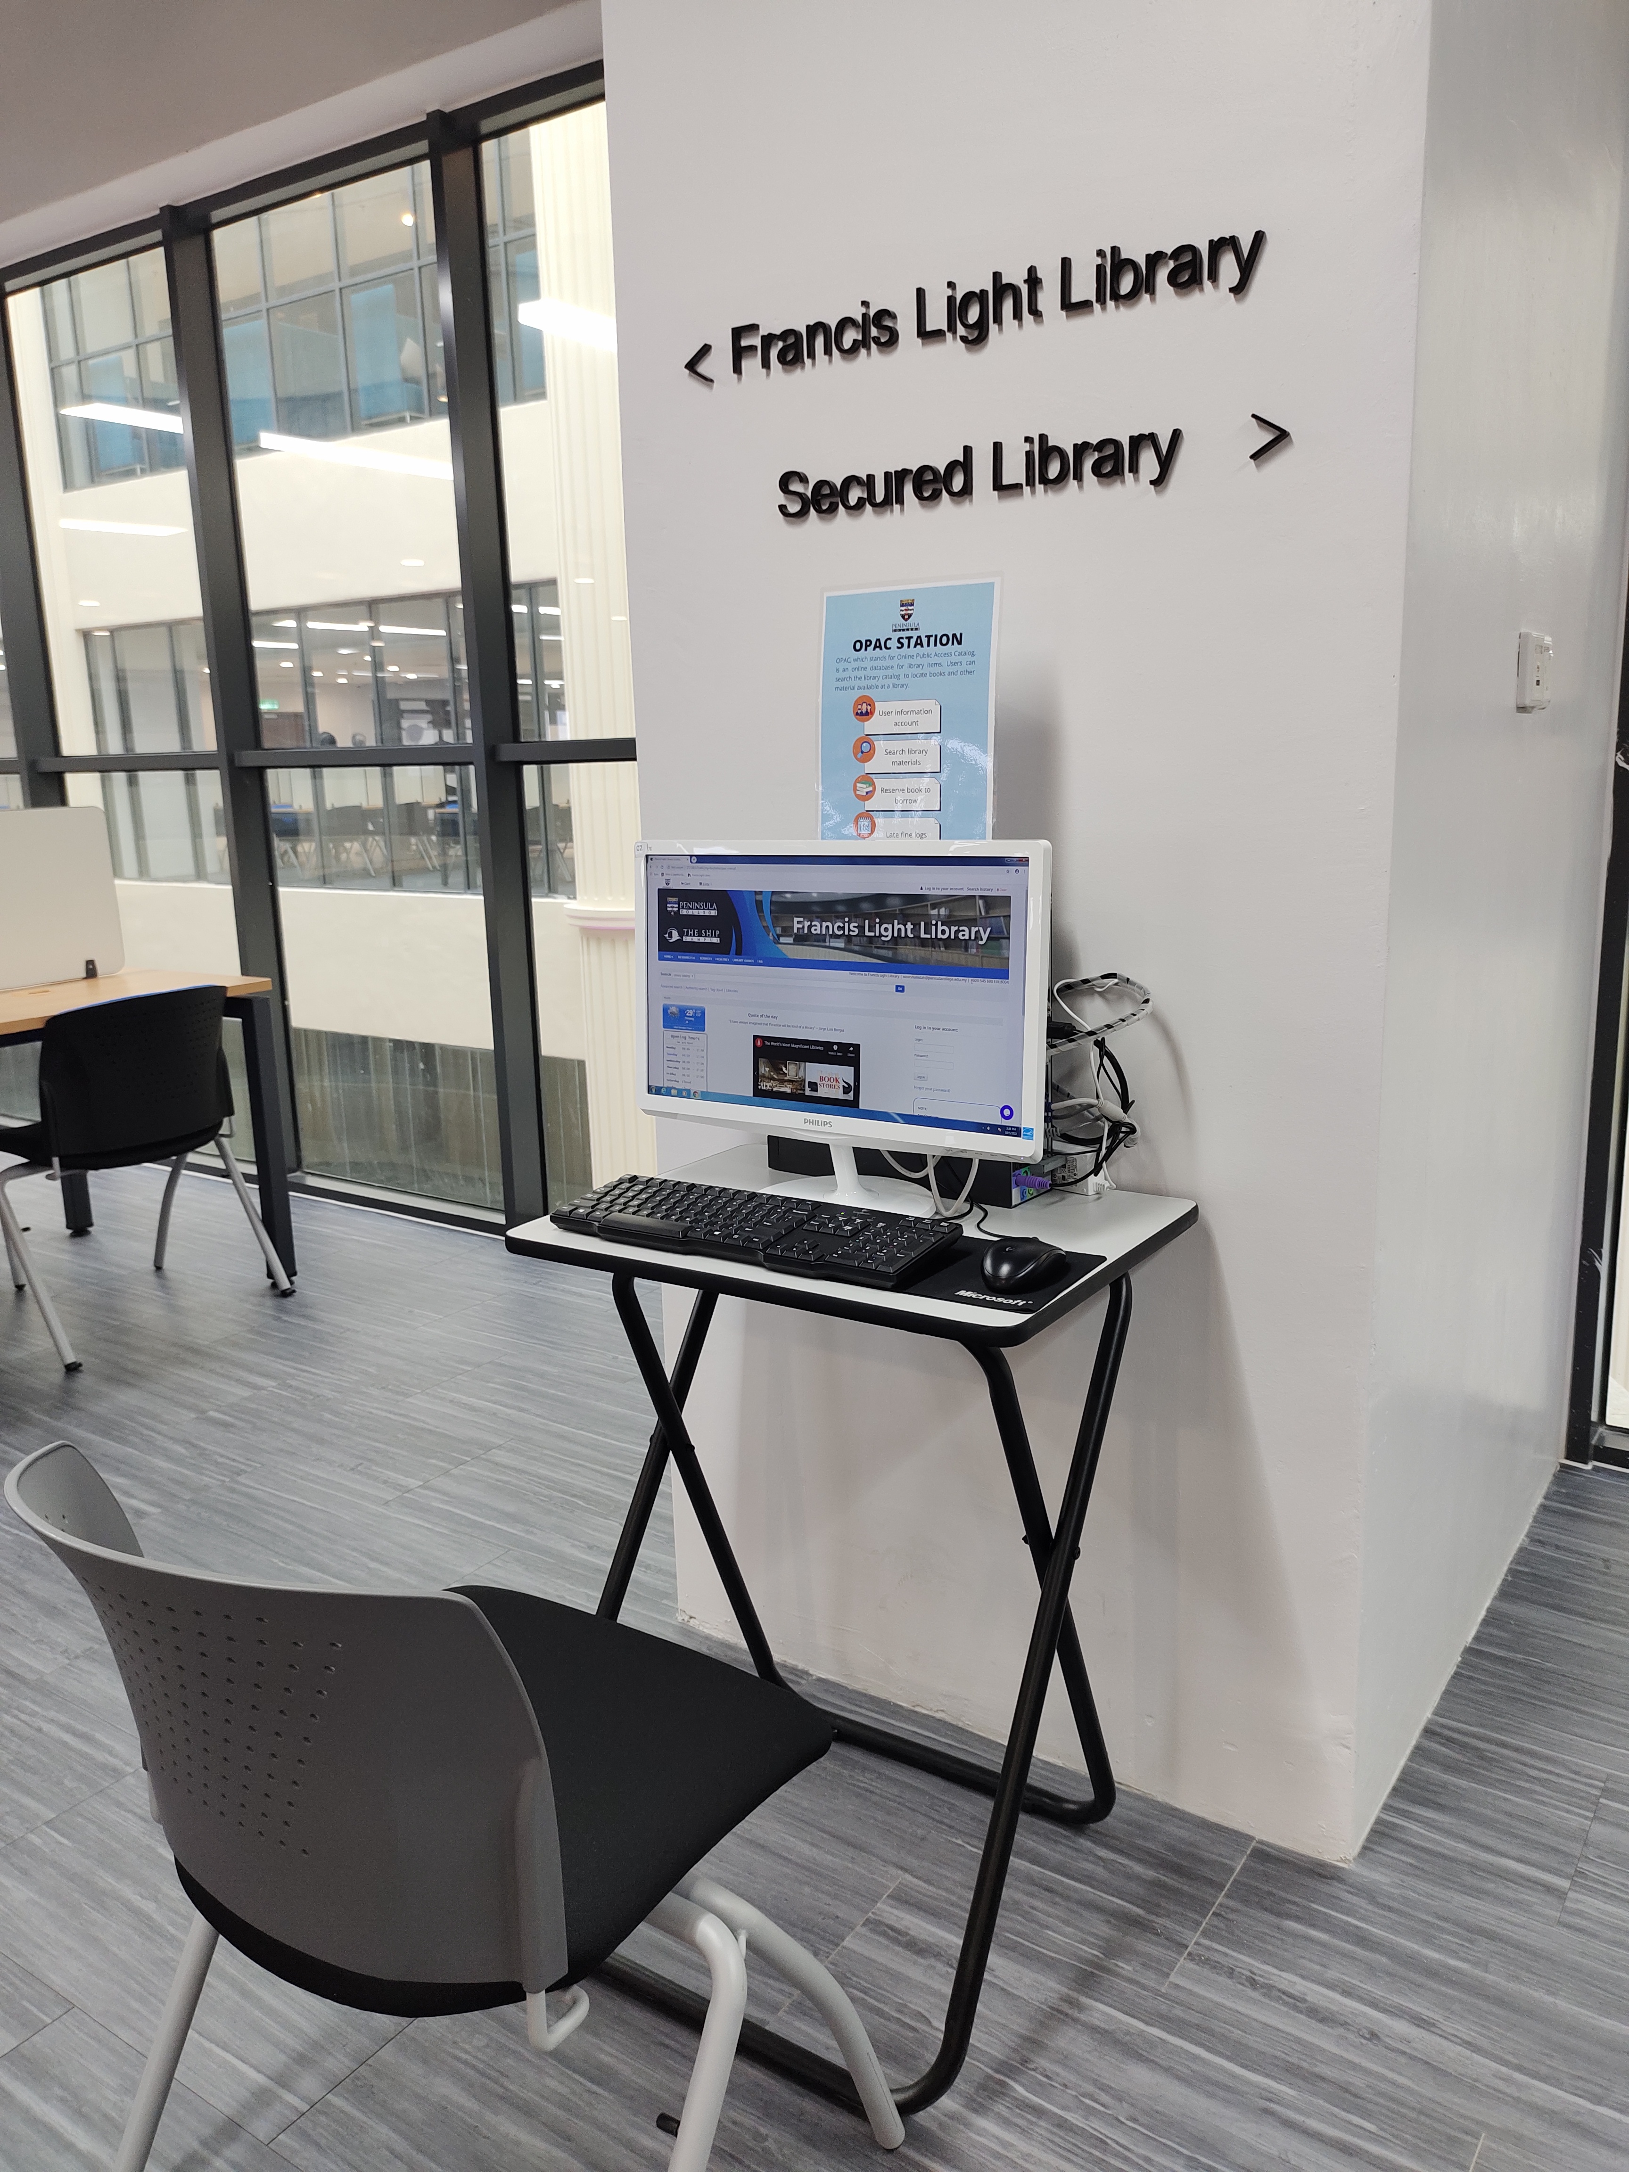
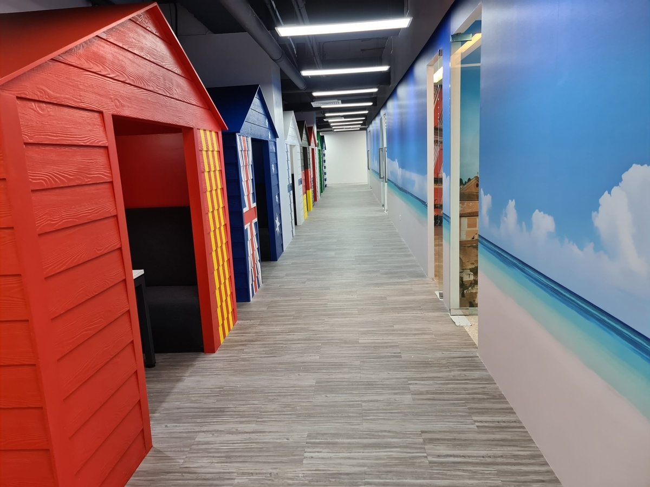
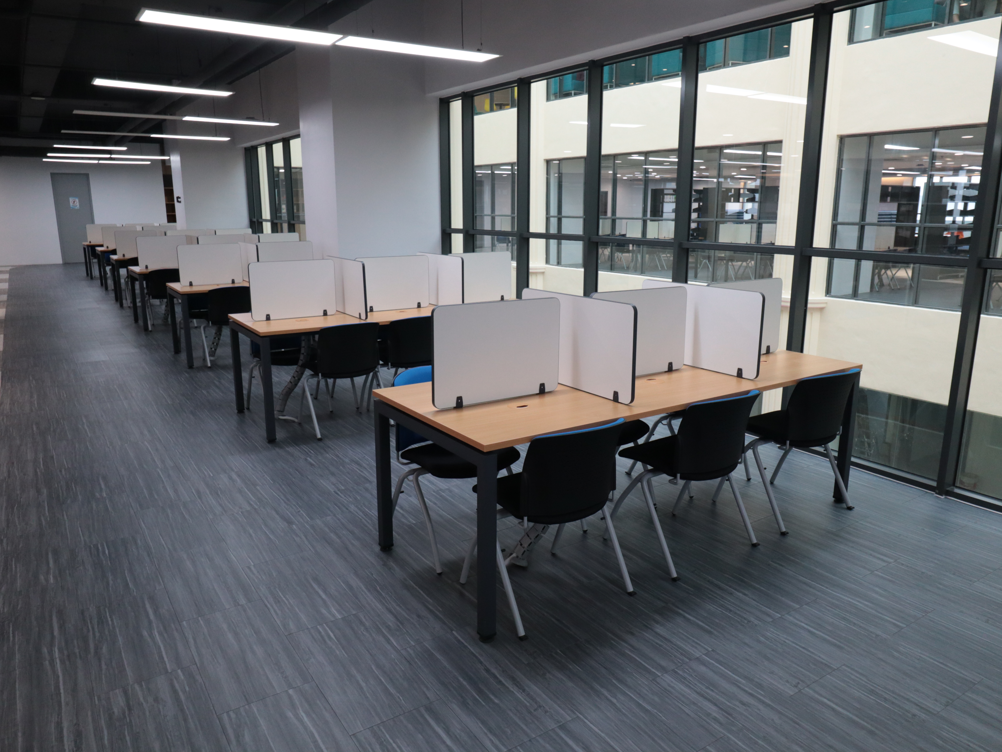
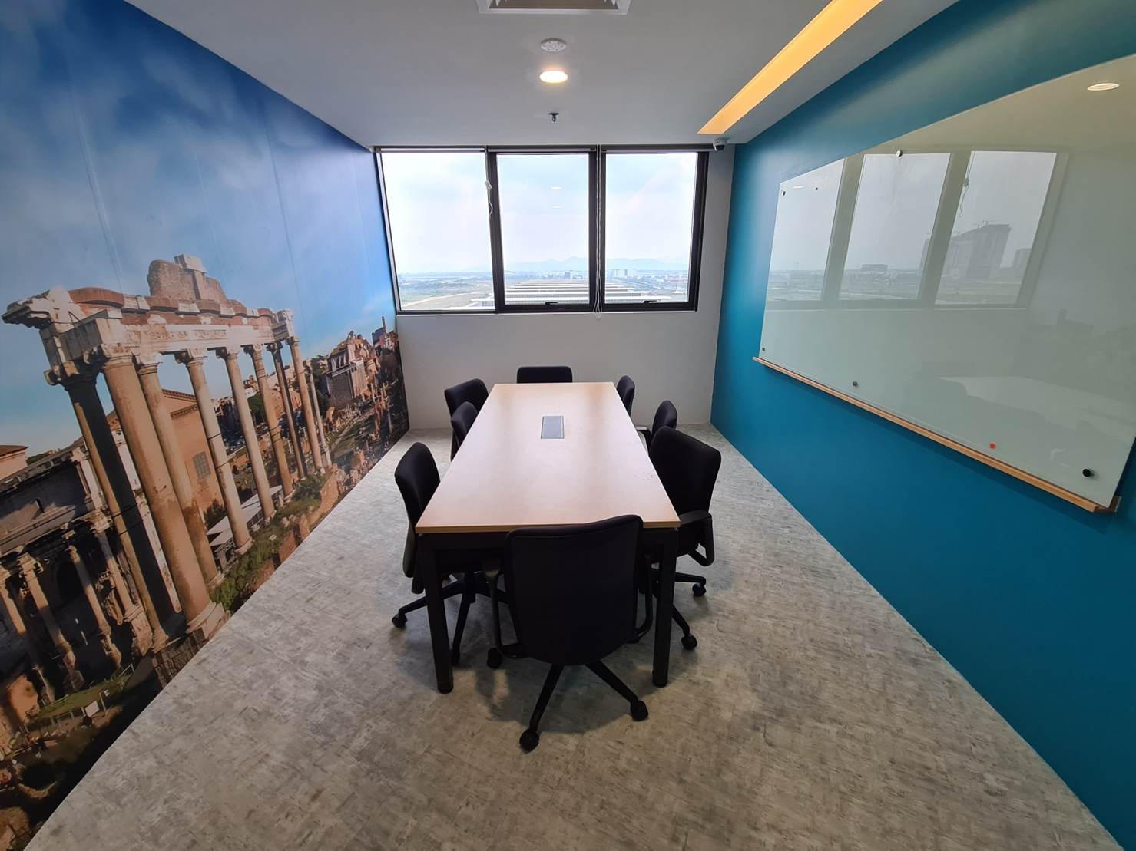
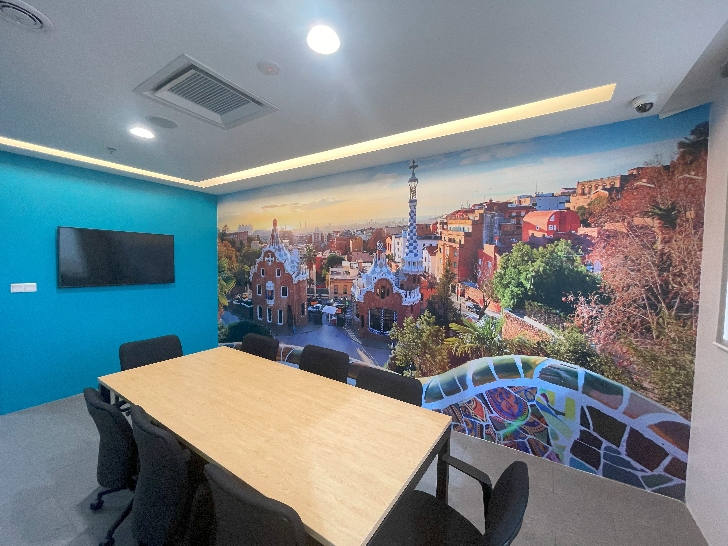
LIBRARY FACILITIES
  Casual and Fun Study Area
  OPAC Station
  Printing / Photocopying Station
  Private Study Area (Brighton Beach)
  Discussion Rooms (Mediterranean Ports)
  Serious Study Area

Slide 17
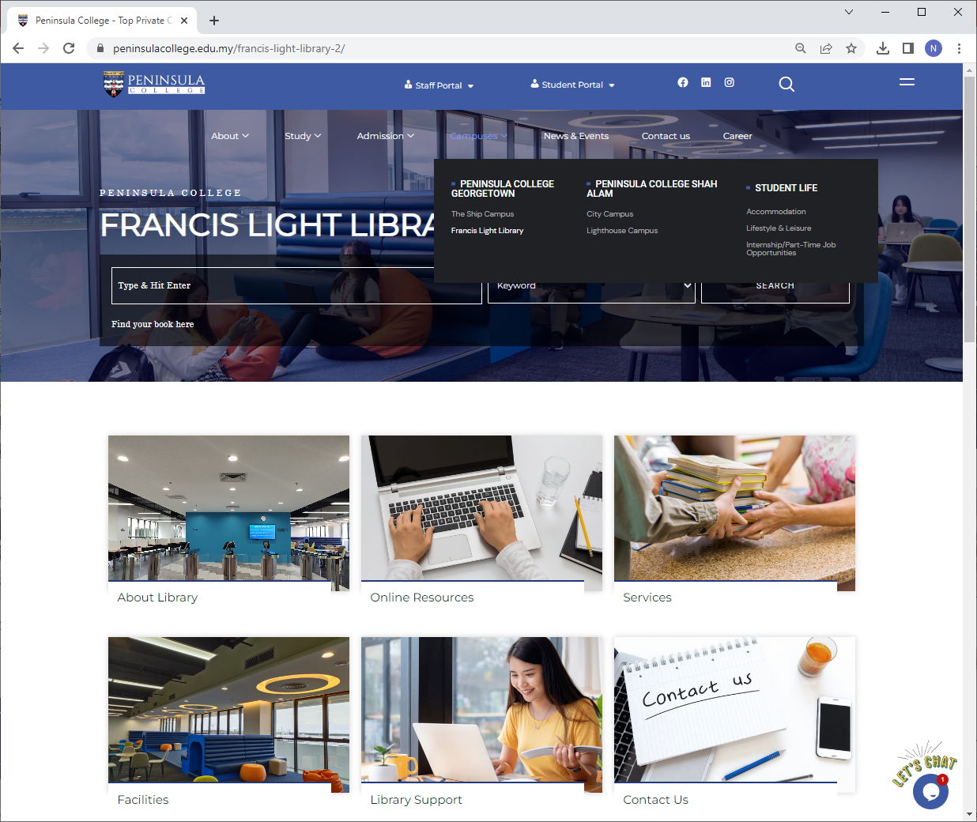

https://peninsulacollege.edu.my/library/
LIBRARY WEB LANDING PAGE
  Shortcut to OPAC searching box
  Further information about library, online resources, services, facilities, library support and contact us.

Slide 18
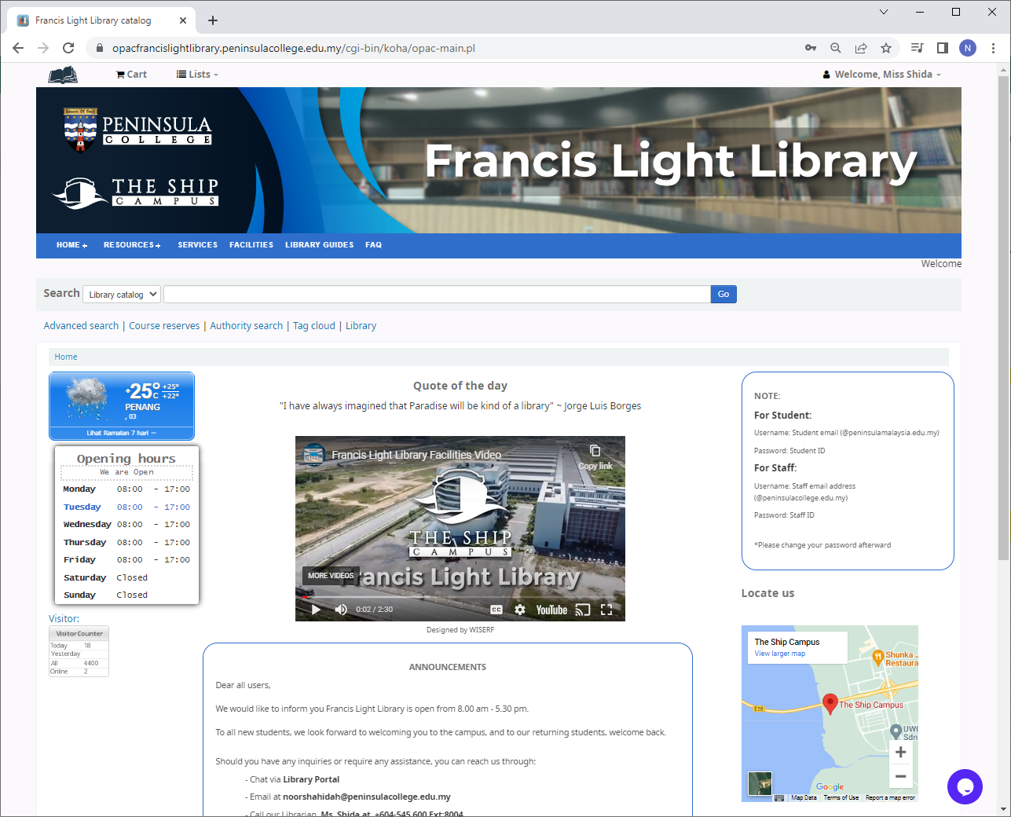

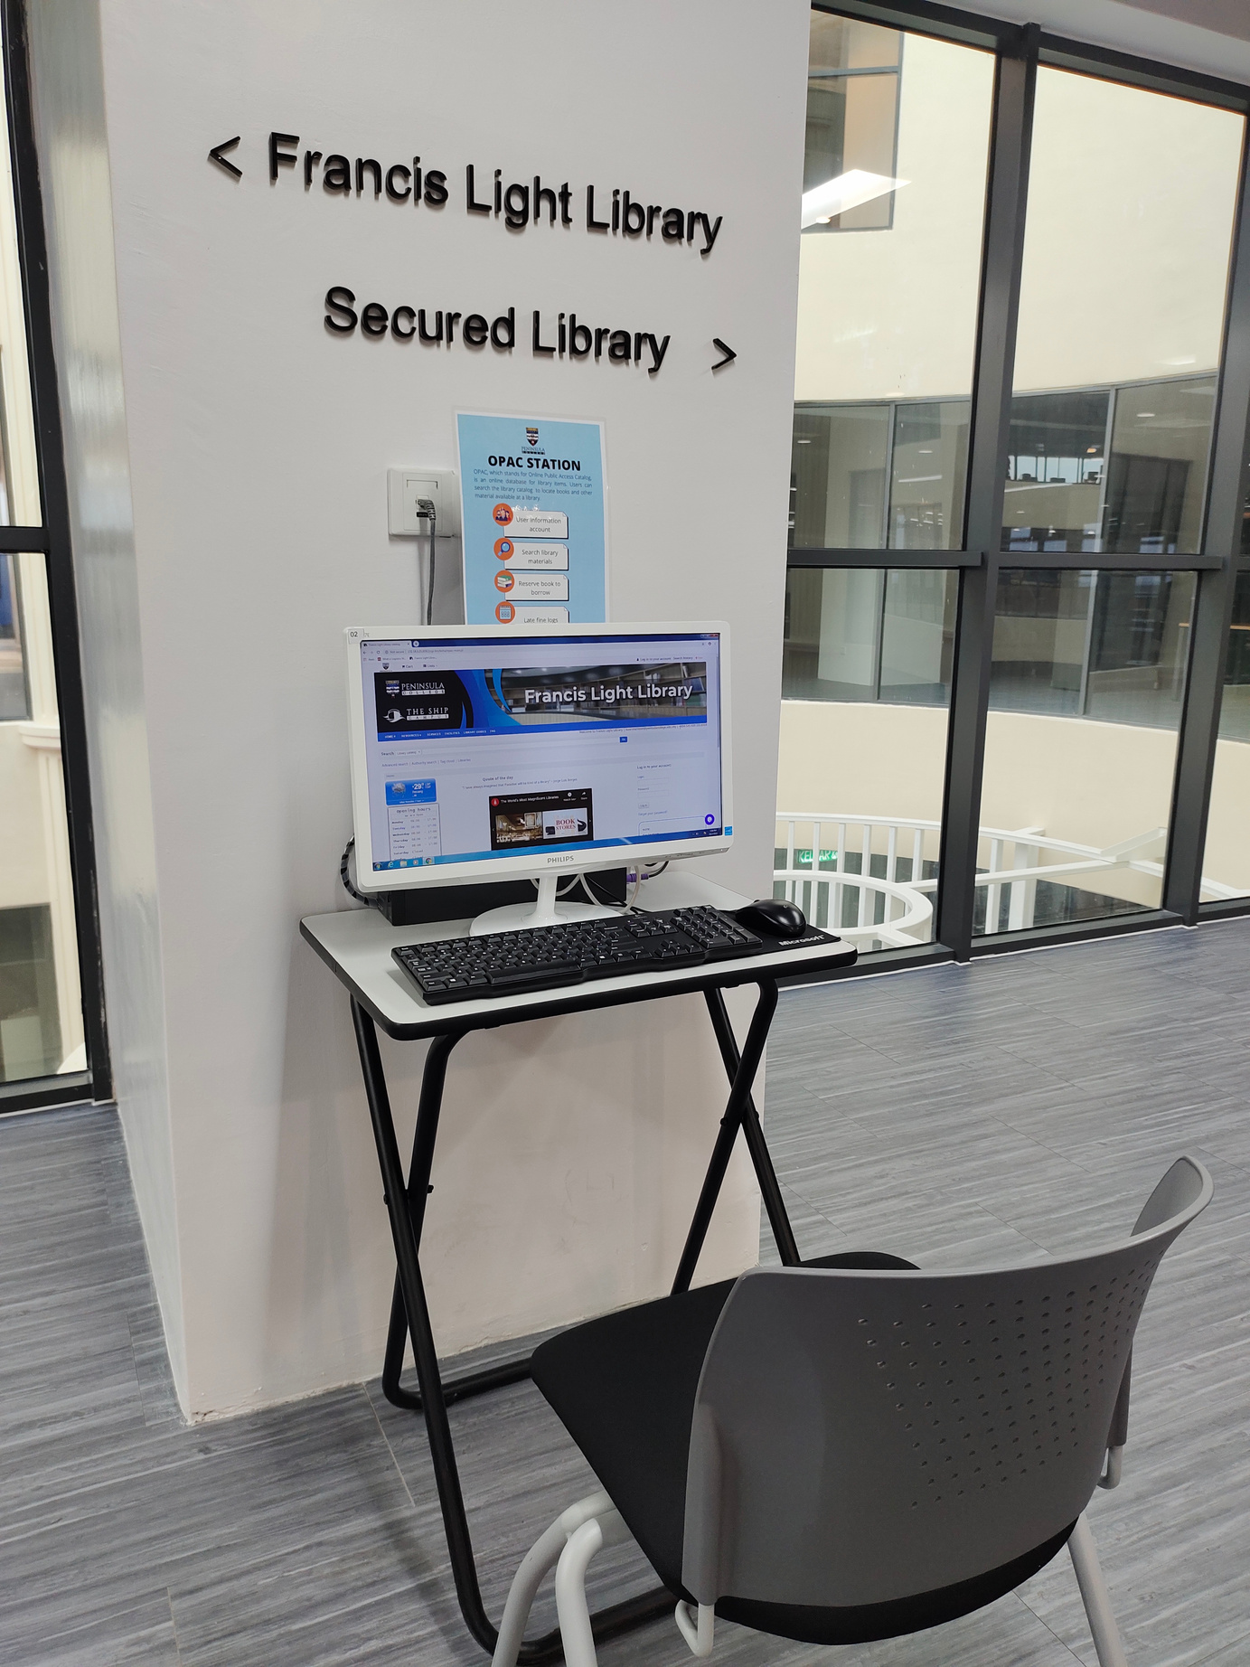


https://opacfrancislightlibrary.peninsulacollege.edu.my
Web OPAC
  Stands for Online public Access Catalog
  Web OPAC – Library catalogue system based on web used to locate items in the library.
SEARCHING
PATRON RECORD
RESERVATION
RENEWAL

Slide 19
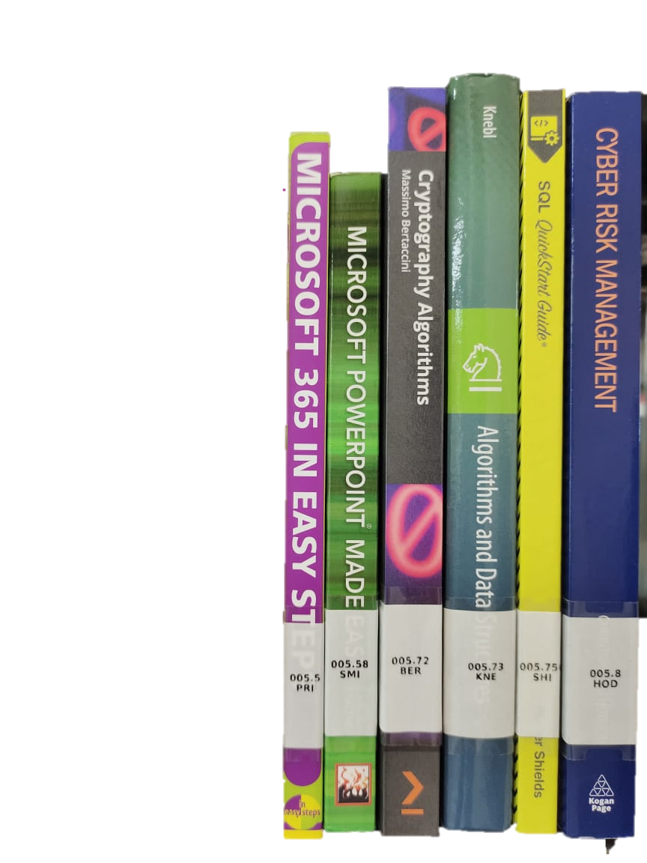
RETRIEVING PRINTED BOOKS What is Call Number?
000 | Computer science, information and general work
100 | Philosophy and psychology
200 | Religion
300 | Social sciences
400 | Language
500 | Science
600 | Technology
700 | Art and recreation
800 | Literature
900 | History and geography
Broader Subject Area
Narrower Subject Area
005.8
HOD
Cutter Number: First 3 letters of author’s last name
  Library books are arranged using Dewey Decimal Classification System (DDC).The system allocates number ranging from 000-900 to specific subject areas.
  A call number is like an address: it tells us where the book is located at the library shelf.

Slide 20
  PART 2 :
  ACCESS TO ONLINE LIBRARY RESOURCES
  Proquest ebook Central
  Francis Light Digital Library (Dspace)
  U-Pustaka
  UOP Electronic Library

Slide 21
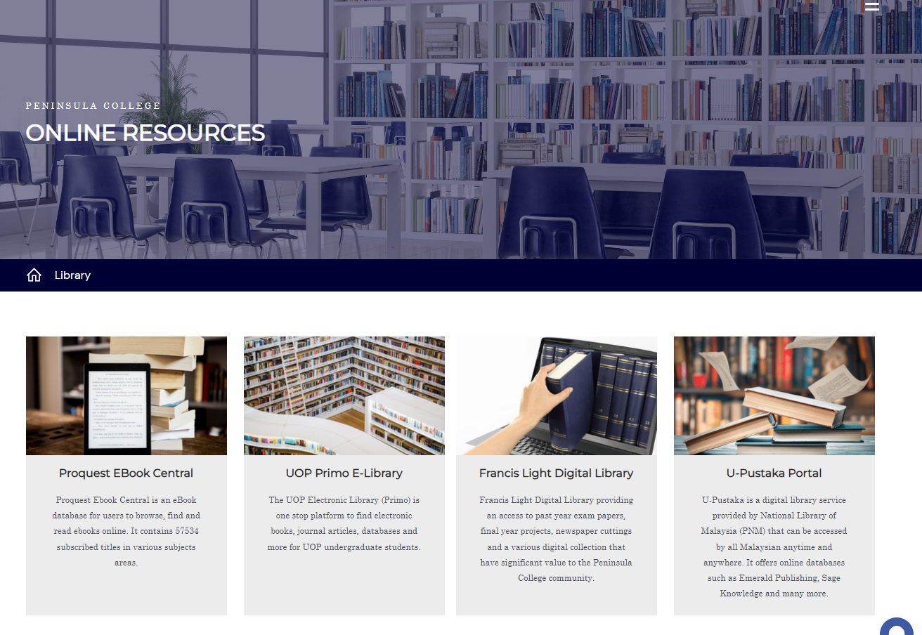

Noor Shahidah

Slide 22


What is ProQuest?
ProQuest Ebook Central is an e-book database for users to browse, find, and read e-books online.
Books can be read online in the web browser or can be downloaded for offline reading.
Individual chapters can be downloaded as PDF files. Download limitations may apply to certain titles, so please check the title for further information.

Slide 23

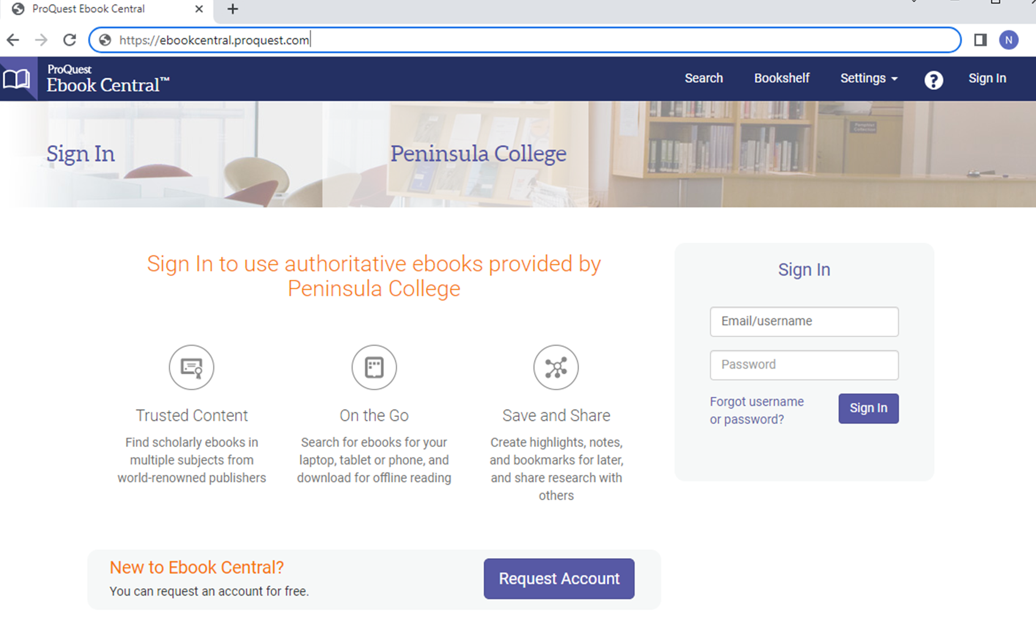


ProQuest eBook Central
Go to https://ebookcentral.proquest.com/auth/lib/alcm/
Sign in by key in the username and password as approved account
First time user please ‘request account’ and fill up details

Slide 24
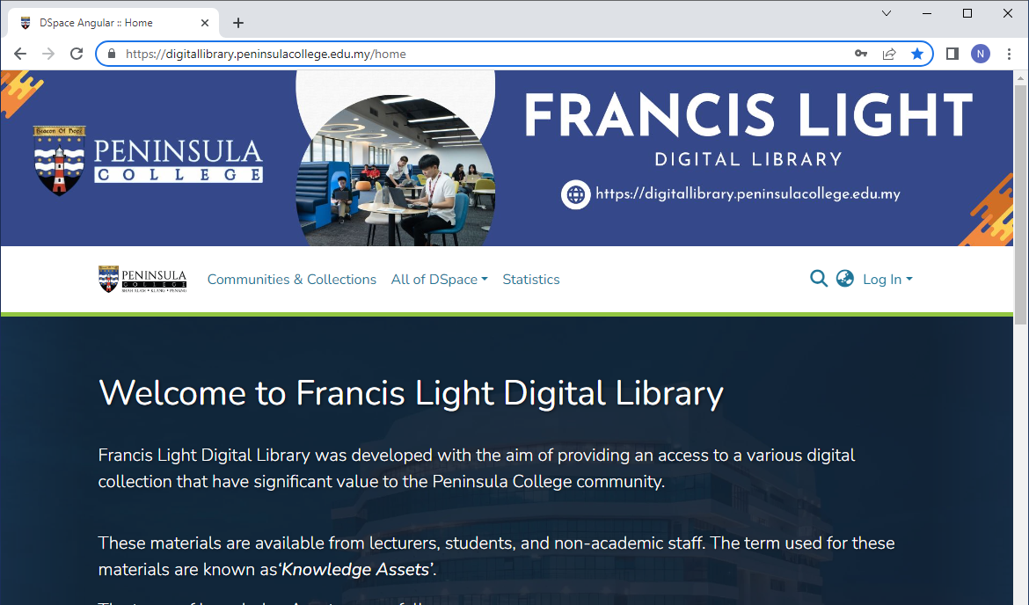
Francis Light Digital Library
https://digitallibrary.peninsulacollege.edu.my
Campus Corporate Resources
Electronic books
Lecturer’s Publications
Past Year Exam Papers
Research Papers / Project Dissertation

Slide 25

What is u-Pustaka
u-Pustaka is a digital library service by National Library of Malaysia (Perpustakaan Negara Malaysia) that can be accessed by all Malaysians anytime and anywhere.
u-Pustaka also offers online databases such as Ebscohost, eLaw.my, Overdrive, ODILO, J-Gate, and many more.

Slide 26

What is Primo?
Use Primo to discover specialist databases, theses, books@ebooks, journal articles and more – both printed and digital – with a single search.
Primo is library search tool to help you find the best quality resources to support your learning, teaching and research.

Slide 27
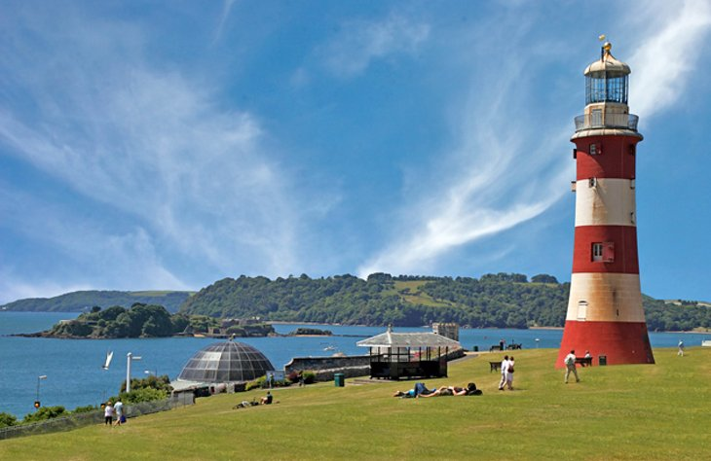
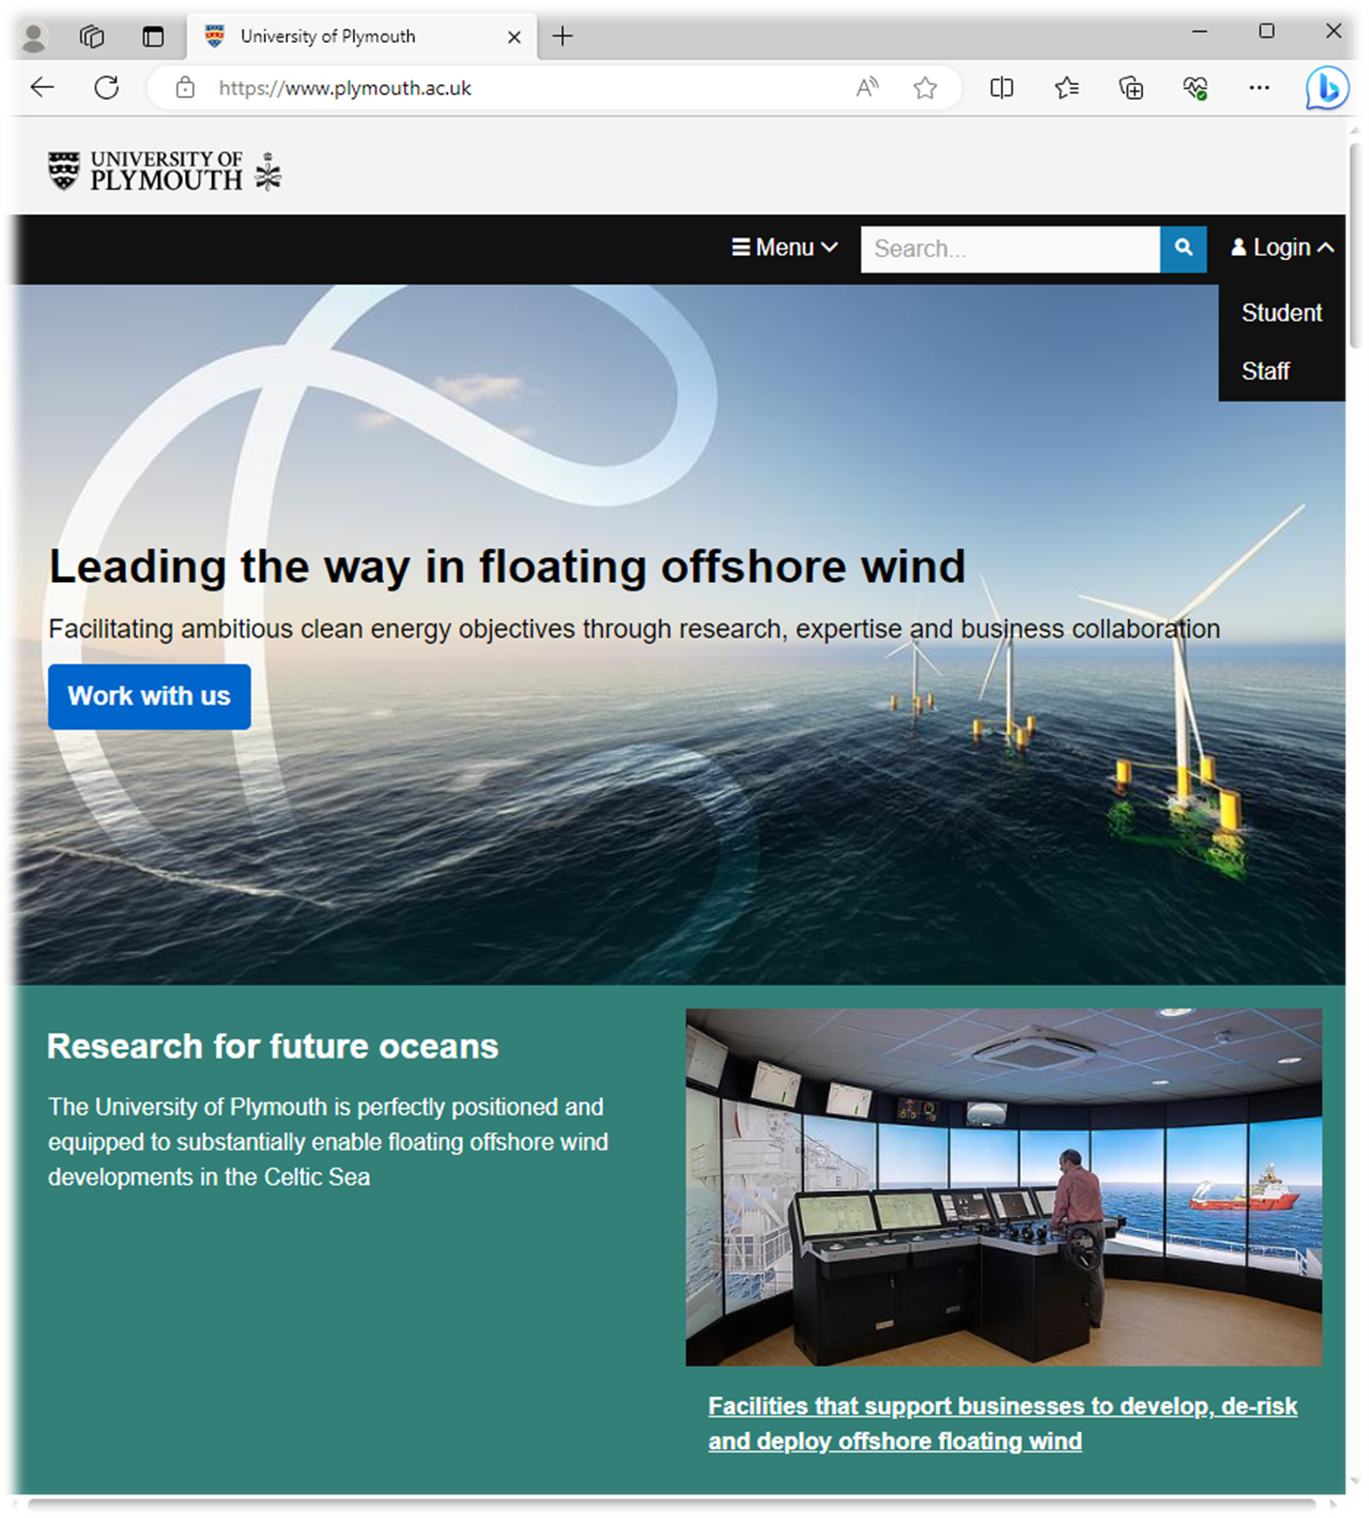
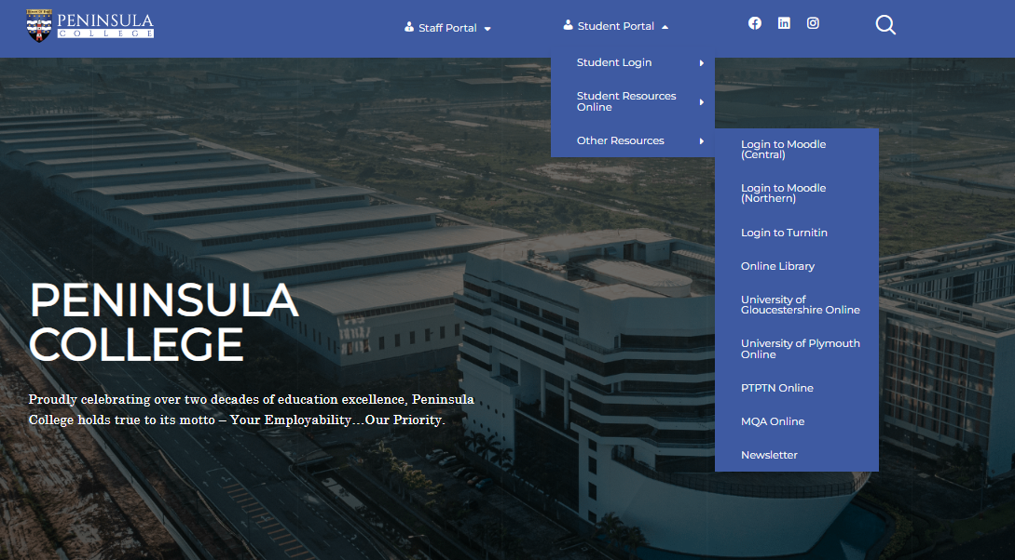

Getting access to UOP E-Library (Primo)
3.
1.
2.

Slide 28
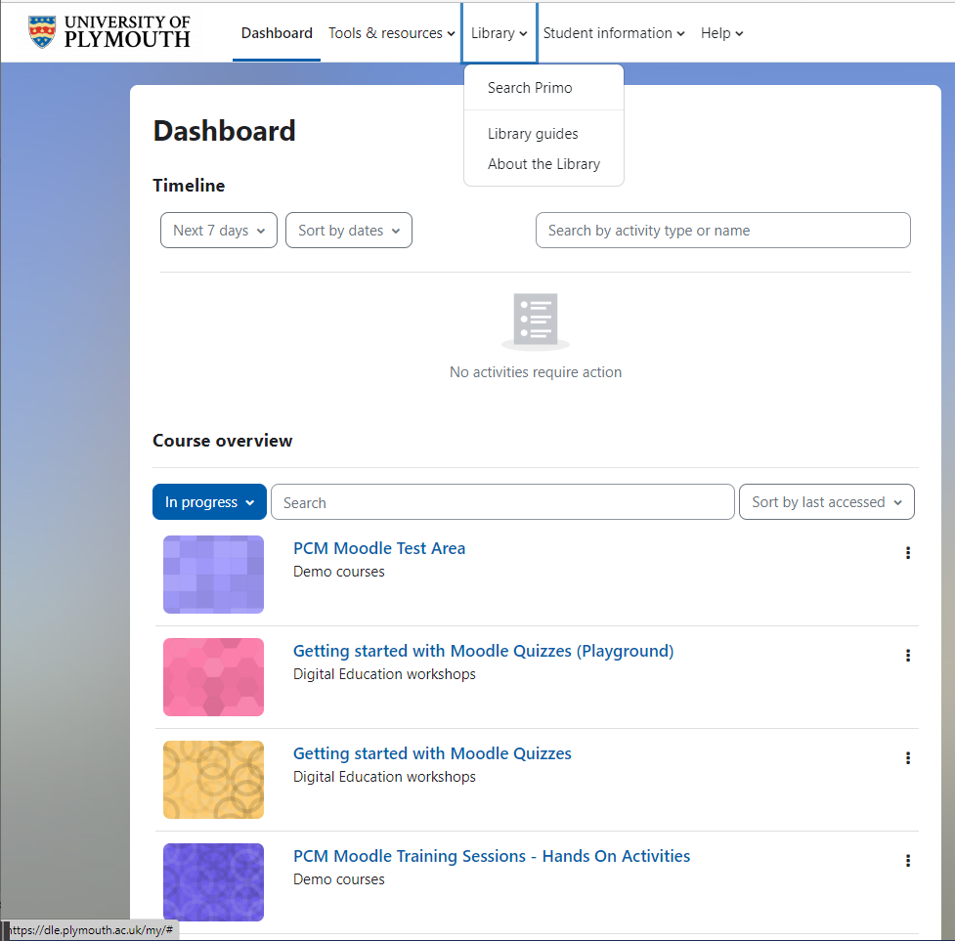
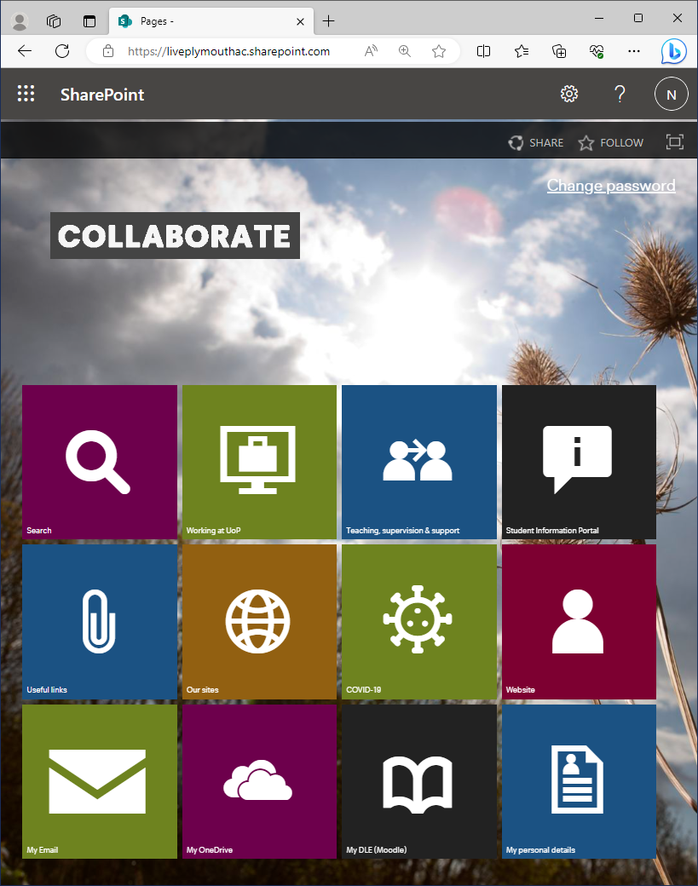
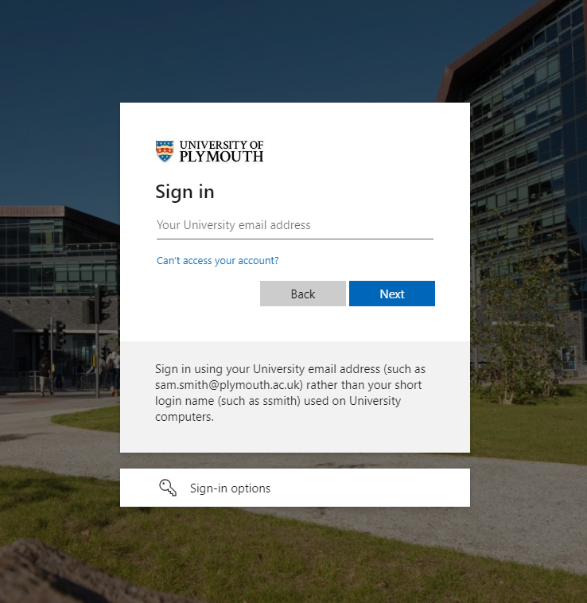
6.
4.
5.

Slide 29
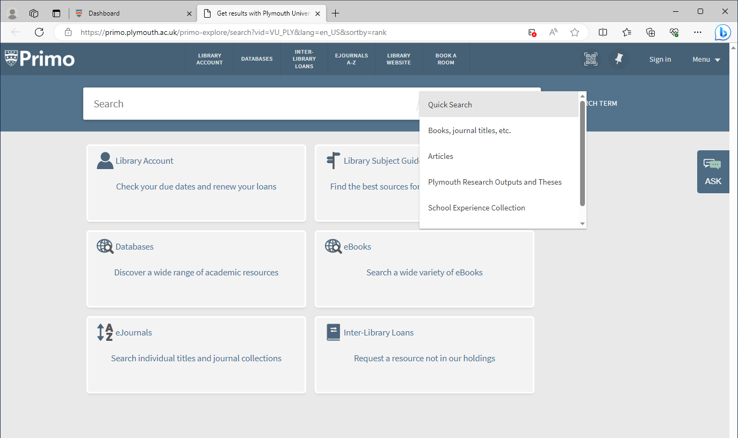
Menu breakdown and their functions

Slide 30
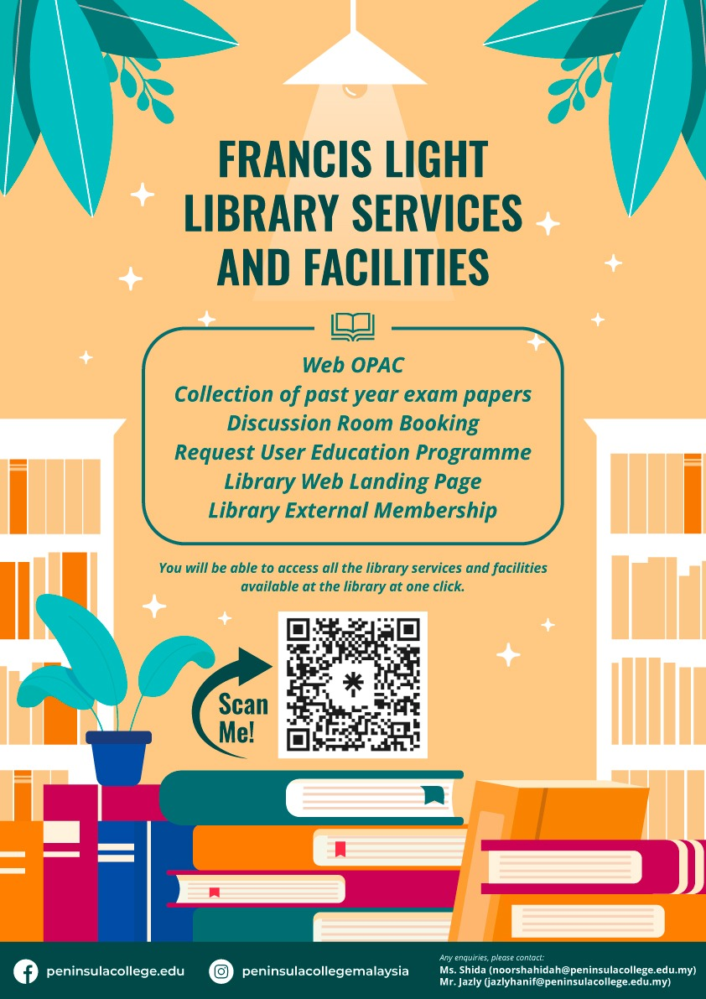
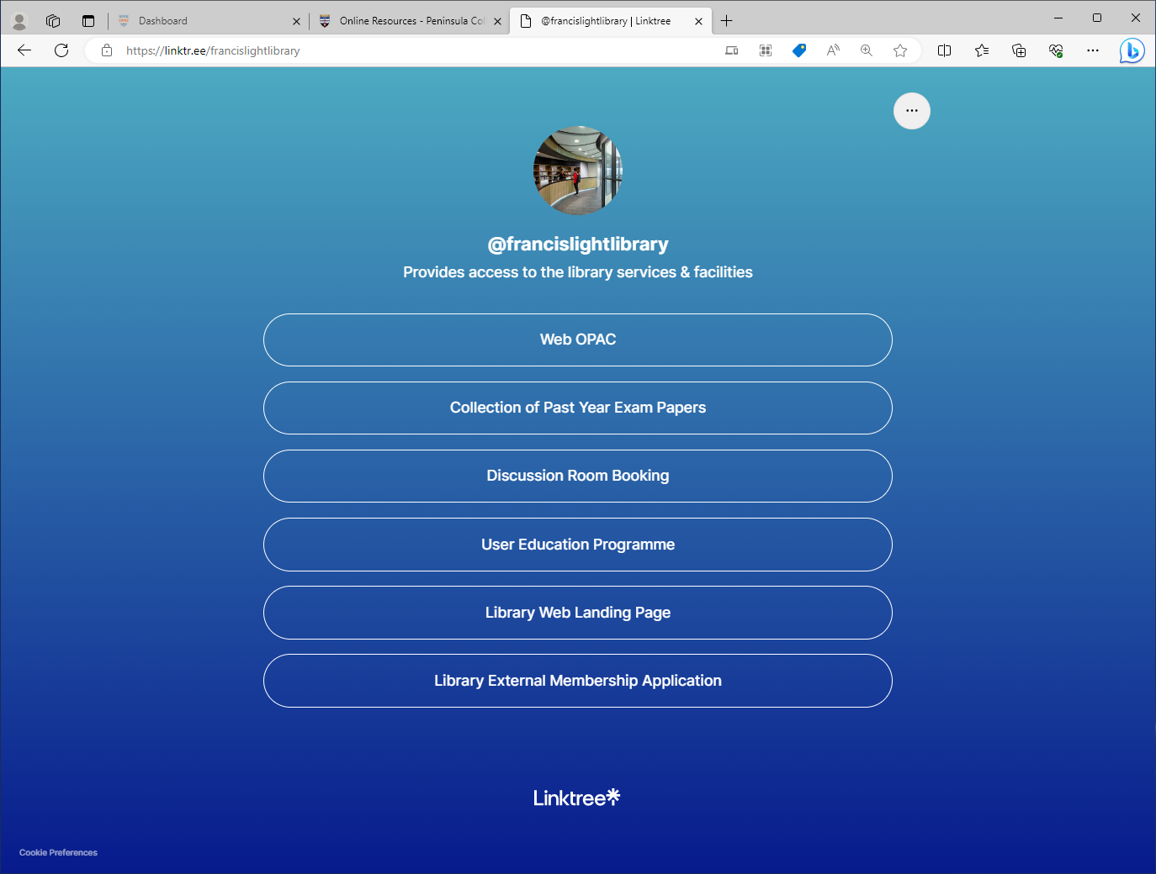
https://linktr.ee/francislightlibrary

Slide 31
USEFUL LINKS
  Library Landing Page: https://peninsulacollege.edu.my/library/
  KOHA OPAC : https://opacfrancislightlibrary.peninsulacollege.edu.my/
  Library discussion room booking system : https://francislightlibrary.appointlet.com/
  Proquest E-Book Central : https://ebookcentral.proquest.com/auth/lib/alcm/
  Access to Library Digital Collection : https://digitallibrary.peninsulacollege.edu.my/home
  Portal u-Pustaka : https://www.u-library.gov.my/portal/
  UOP Library services : https://www.plymouth.ac.uk/services/library-services
  Contact Librarian :
    noorshahidah@peninsulacollege.edu.my
    jazlyhanif@peninsulacollege.edu.my

Slide 32

Thank you !
We look forward to assist you..

