Slide 1

DRONE SAFETY MANAGEMENT SERVICE (DSMS)
Lecturer : MR MOHAMAD KHAIRUDDIN BIN ABDUL HALIM

Slide 2


ORGANIZATION CHART

Slide 3
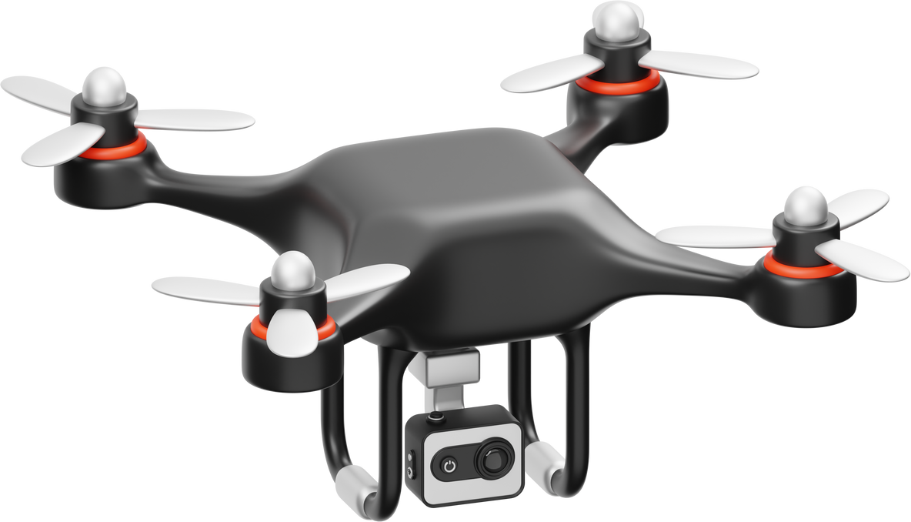
INTRODUCTION
To enhance fire safety and rescue efficiency by introducing firefighting drones that assist in high - rise building fire suppression by inspired the latest technological advancements

Slide 4
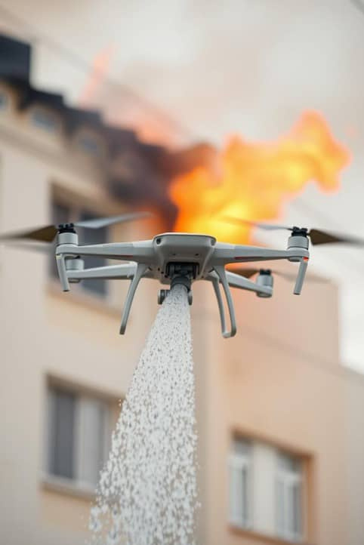
PROJECT OBJECTIVES
  Develop a drone - based firefighting system to assist emergency responders.
  Ensure efficient and rapid fire suppression in high - rise buildings.
  Reduce the risks faced by firefighters in hazardous environments.
  Integrate AI and autonomous navigation for precise targeting of fire outbreaks.
  Demonstrate how technology can assist humans rather than replace them.

Slide 5



CONCEPT EXPLANATION
🔥
Key Advantages
Rapid response, remote operation for safety and also effective in high - rise buildings, forest fire and industrial fire.
Inspired by China’s
Integrates AI navigation, heat -resistant materials and automated spraying.
Notes:
inspired by 中国 symbol 在左边
advantage 右边
remote 图画
下面放high r..................
放bullet

Slide 6

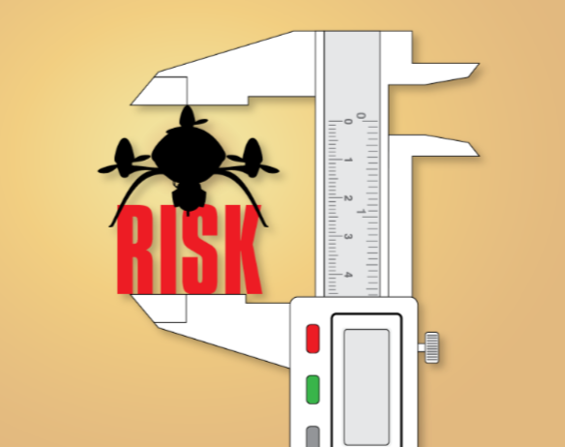

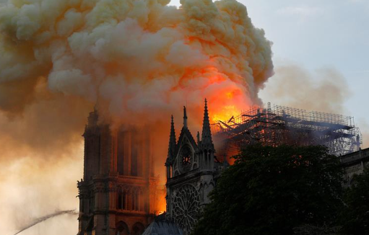
PROBLEM STATEMENT

Slide 7
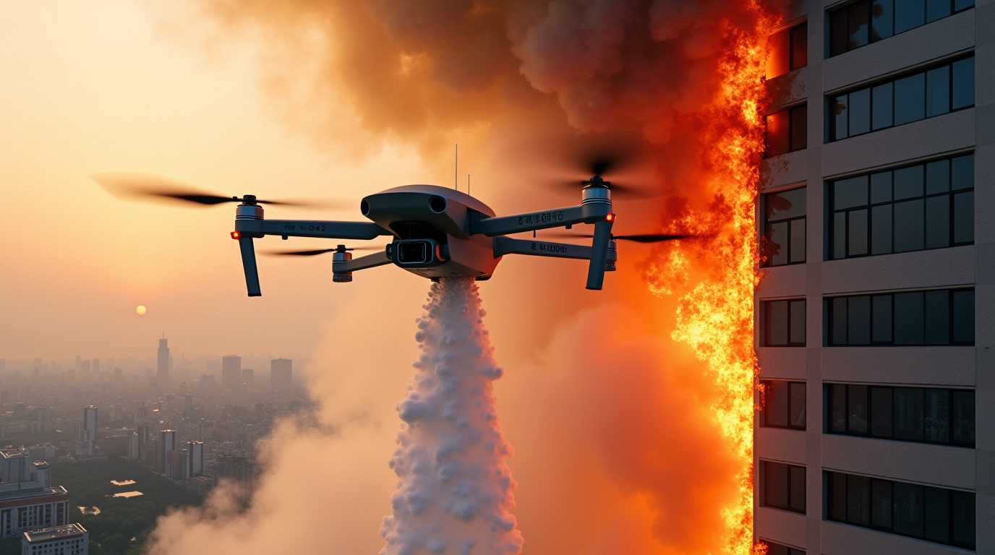



Understanding
FUNCTION
Design to operate in extreme fire conditions
Thermal imaging camera
AI - Driven Navigation

Slide 8
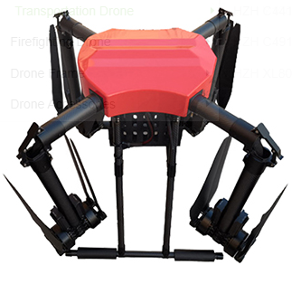
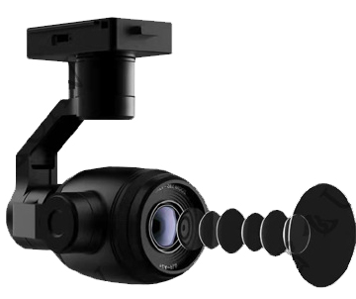
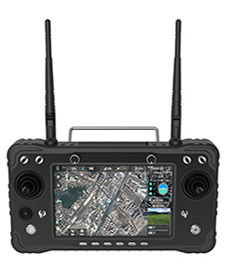
Key
FEATURES
Drone Specifications
  Foldable design for easy transportation.
  Expanded Dimensions: 2500mm × 2500mm × 790mm
Camera & Imaging System
  4K video recording at 30fps, 85° Field of View
  Infrared thermal imaging for low-visibility conditions
Remote Control System
  Control range: up to 30km
  7-inch high - brightness touchscreen (2000cd/m²)

Slide 9

FIRE SUPPRESSION SYSTEM
Integrated Firefighting System:
    50L liquid storage tank for water, foam or fire retardants.
    High-pressure spraying system for efficient fire suppression.
Intelligent Battery System:
    53.8V, 28000mAh high - capacity battery.
    Quick-swappable for continuous operations.
    Overcharge protection & temperature monitoring.

Slide 10
PROJECT SCOPE
Project Scope
  Develop a scaled - down prototype of an autonomous fire - fighting drone
  Utilize commercially available components & DIY materials for cost - effectiveness
  Demonstrate key functionalities of real fire - fighting UAVs
Innovation & Impact
  Provides insights for future autonomous firefighting UAV development
  Encourages research into affordable fire safety solutions

Slide 11
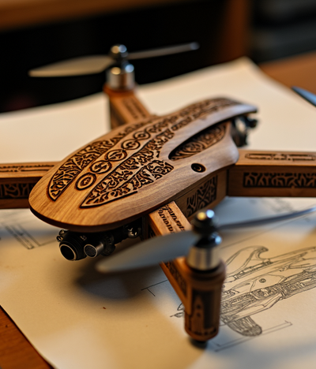

Prototype Development
Drone Model
  E88 RC Quadcopter (Affordable & portable)
Features
  Basic aerial maneuverability & manual control
Purpose
  Simulate navigation in fire zones
DIY Fire Suppression System
Mechanism
  Pressurized water dispersal creating a fine mist
  Adjustable pressure for controlled suppression
Significance
  Demonstrates aerial fire suppression feasibility
  Showcases an accessible & cost-effective approach

Slide 12

Join Our
Innovation
Venue : The Ship Campus (TSC)
Date & Time : 26 Mar 2025 (2:30pm - 5:30pm)
OPEN FOR OUTSIDER TO VISIT TOGETHER

Slide 13
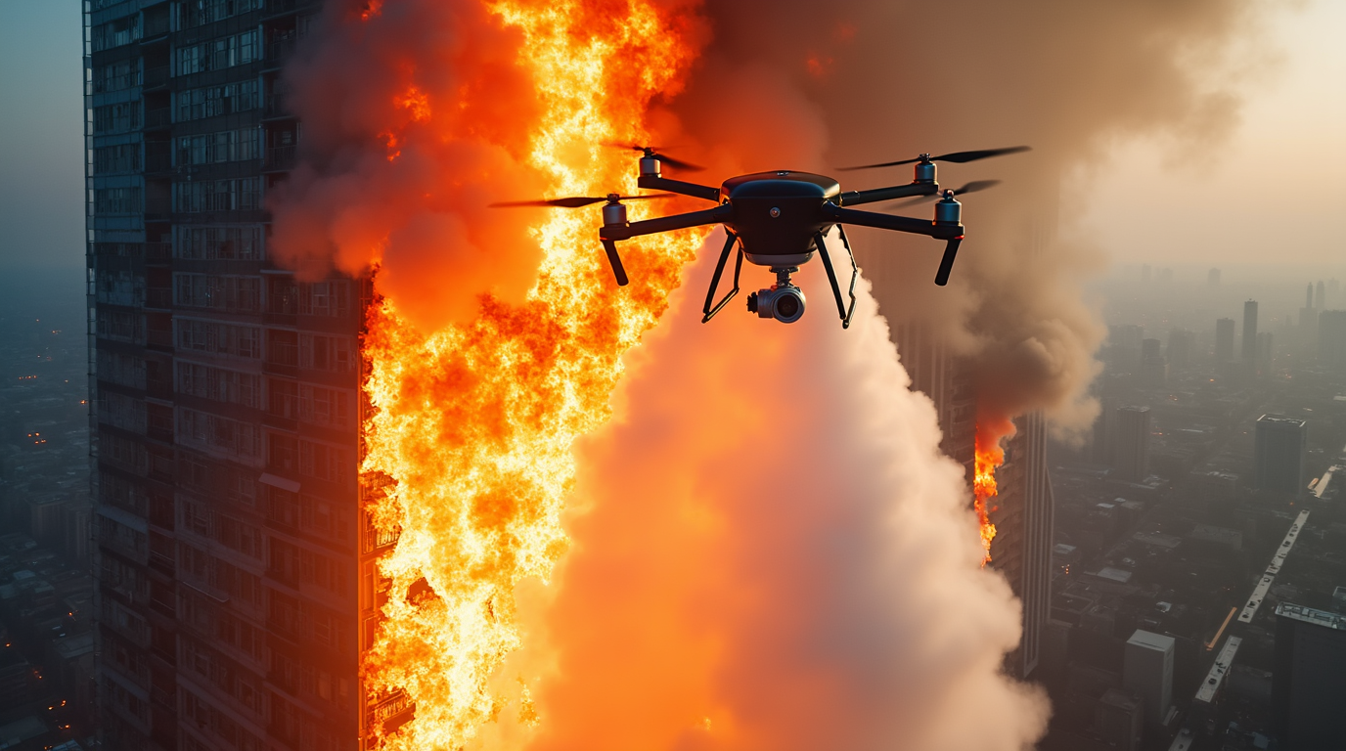
Summary
    Drone technology enhances fire suppression efficiency.
    AI integration enables precise targeting and automation.
    Reduces human risks and improves response time.
Future Improvements
    Implement AI-based autonomous navigation.
    Enhance fire suppression mechanisms for better efficiency.
    Develop high-performance batteries for extended flight duration.
Conclusion
Summary

Slide 14



